Slide 1

The Future of Discrimination Law
Professor Sandra F. Sperino
University of Missouri School of Law

Slide 2
Overview of federal discrimination law
Time Machine
Three Big Changes

Slide 3
Title VII

Slide 4
Title VII: Two main provisions
(1) to fail or refuse to hire or to discharge any individual, or otherwise to discriminate against any individual with respect to his compensation, terms, conditions, or privileges of employment, because of such individual’s race, color, religion, sex, or national origin

Slide 5
(2) to limit, segregate, or classify his employees or applicants for employment in any way which would deprive or tend to deprive any individual of employment opportunities or otherwise adversely affect his status as an employee, because of such individual’s race, color, religion, sex, or national origin

Slide 6
Age Discrimination in Employment Act (ADEA)

Slide 7
Americans with Disabilities Act

Slide 8
Section 1981
Prohibits race discrimination in employment and other areas
Passed over the veto of President Andrew Johnson

Slide 9
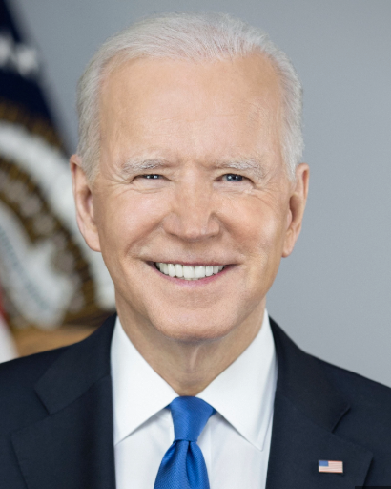
Pregnant Workers Fairness Act
Bipartisan support

Slide 10
Find a friend.
A worker alleges that her supervisor gave her a negative evaluation because of her religion.
The supervisor states that she gave the worker a negative evaluation because of poor work quality.
The evaluation does not have any immediate consequences.
Can the worker successfully bring a Title VII claim if she can prove the evaluation was because of her religion?
How would you analyze this?

Slide 11
Title VII
(1) to fail or refuse to hire or to discharge any individual, or otherwise to discriminate against any individual with respect to his compensation, terms, conditions, or privileges of employment, because of such individual’s race, color, religion, sex, or national origin

Slide 12
Did the employer?
Discriminate (take a negative action) in the terms, conditions or privileges of employment
Because of
Religion

Slide 13

Time machine

Slide 14
Frameworks
Disparate treatment
Direct evidence
Mixed motive
McDonnell Douglas
Harassment
Retaliation
Accommodation
  Religion
  Disability
  Pregnancy
Disparate impact
  Title VII
  ADEA
  ADA

Slide 15
McDonnell Douglas
The trickiest of the frameworks

Slide 16
Three-part, burden-shifting test
A prima facie case
Defendant must articulate a legitimate, nondiscriminatory reason that is specific
The plaintiff can prevail by establishing pretext OR evidence of discrimination.

Slide 17
Prima facie case
Most circuits required the plaintiff to establish an adverse action as part of the prima facie case.

Slide 18
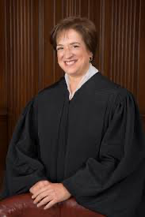
Muldrow v. St. Louis,
601 U.S. 346 (Apr. 17, 2024).
Unanimous
With three concurring opinions

Slide 19
“terms, conditions, or privileges”
Means harm, something that is disadvantageous
No significance or materiality required

Slide 20
Transfer counts because it relates to what, when and where the plaintiff worked.
However, “terms, conditions or privileges” is not confined to a narrow, economic sense.

Slide 21
The Future
Muldrow changes what counts as discrimination.
And has the potential to reorganize the central structure of discrimination law.

Slide 22
The case changes the harm standard in every circuit.

Slide 23
Workers are challenging where to draw the line about what counts as discrimination and what does not count.

Slide 24
Find a friend.
Does a negative evaluation count on its own?
Why or why not?

Slide 25
Workers challenging where to draw line
Negative evaluations
Performance improvement plans
Constructive criticism
Threats of demotion, firing
Moving offices
Taking away or adding responsibilities within job description

Slide 26
Bigger issue: Harassment
Is the severe or pervasive standard in harassment cases consistent with Muldrow? Or is it a materiality standard that is inconsistent with Muldrow?

Slide 27
Courts have been separating harassment from non-harassment disparate treatment since the late 1980s.
And have developed specific sub-doctrines related to each type of discrimination.
If the two are actually the same concept, this will be a major restructuring of discrimination law.

Slide 28
Second Change
Accommodation
Religion
Disability
Pregnancy

Slide 29
History
Religious accommodation required very minimal accommodation.

Slide 30
Pregnancy
Title VII did not require accommodation unless it was evidence of discriminatory intent.
Like, the employer accommodated everything except pregnancy.

Slide 31
Disability
ADA has robust accommodation requirement.
Employer required to accommodate unless undue hardship.

Slide 32
Early 2000s
Limited religious accommodation
Limited pregnancy accommodation
Robust disability accommodation

Slide 33
Now
Accommodation is more unified.
Groff v. DeJoy (2023): robust religious accommodation
PWFA (effective 2023): robust pregnancy accommodation

Slide 34
Accommodation
More unified across religion, pregnancy and disability
With only minor differences
Key idea is whether the needed accommodation is because of the protected trait and whether it constitutes an undue hardship

Slide 35
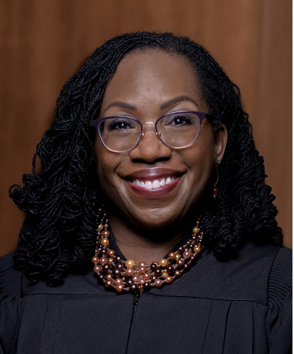
Ames v. Ohio Dept of Youth Servs. (Feb. 2025)

Slide 36
Ames
The prima facie case does not vary depending on whether the plaintiff is a member of a minority or majority group.
Resolved a circuit split in which some circuits had required an additional showing from majority plaintiffs.

Slide 37
A trend
Muldrow = follow the text
Ames = follow the text

Slide 38
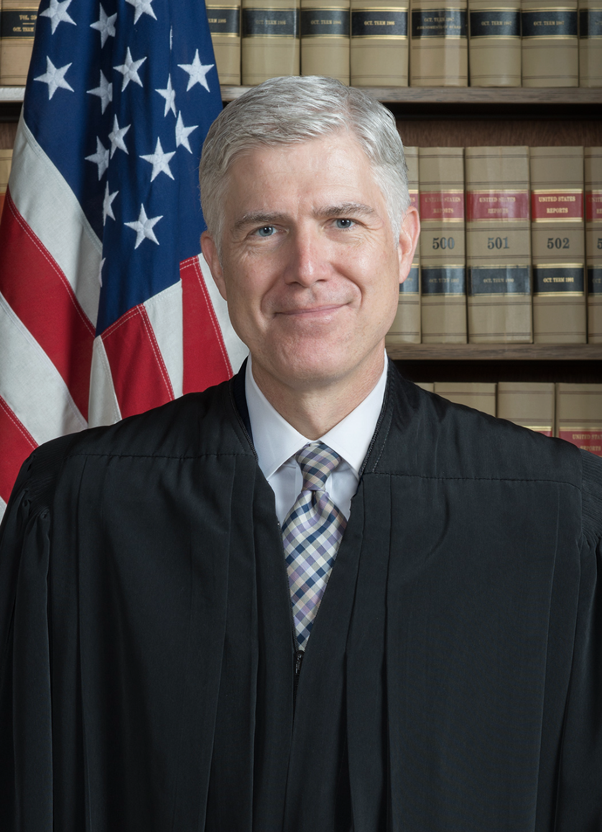
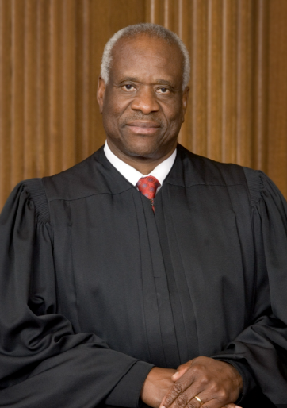
Is McDonnell Douglas consistent with the text of Title VII?
Or with Rule 56?

Slide 39
In the last five years
The distinction between harassment and non-harassment disparate treatment is diminishing (and may disappear).
Accommodation is a more coherent, unified concept across religion, pregnancy and disability.
There are serious challenges to the McDonnell Douglas test and all non-textual aspects of the field.

Slide 40
I hope you have questions!
If you want to read more on the Muldrow issues, https://wustllawreview.org/2025/09/03/when-is-discrimination-harmful/

