Slide 1
Truth, Belief and Fairness
Lawyer as citizen with a special responsibility for the quality of justice
Chuck Henson
Trial Practice Professor of Law
University of Missouri School of Law

Slide 2
What is this?

Slide 3
What does this mean?

Slide 4
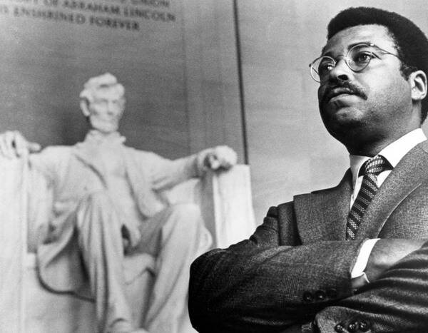
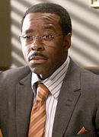
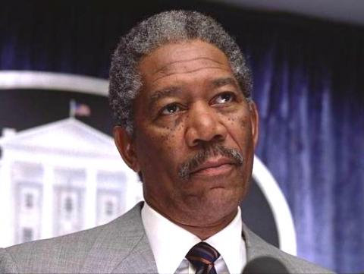

Slide 5
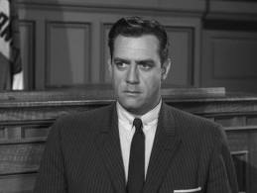
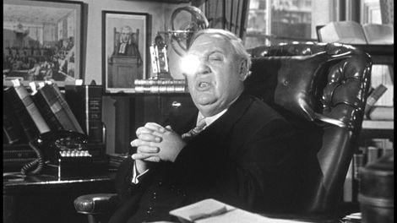
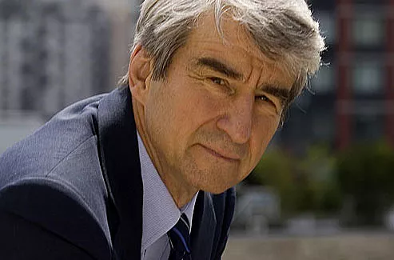

Slide 6
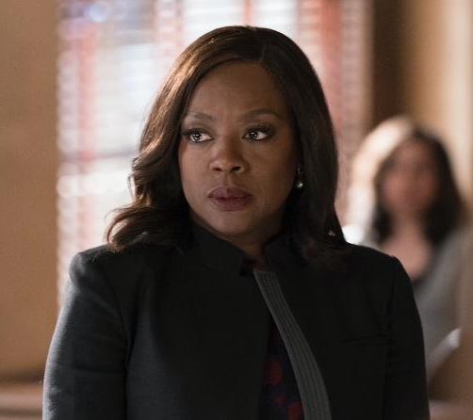
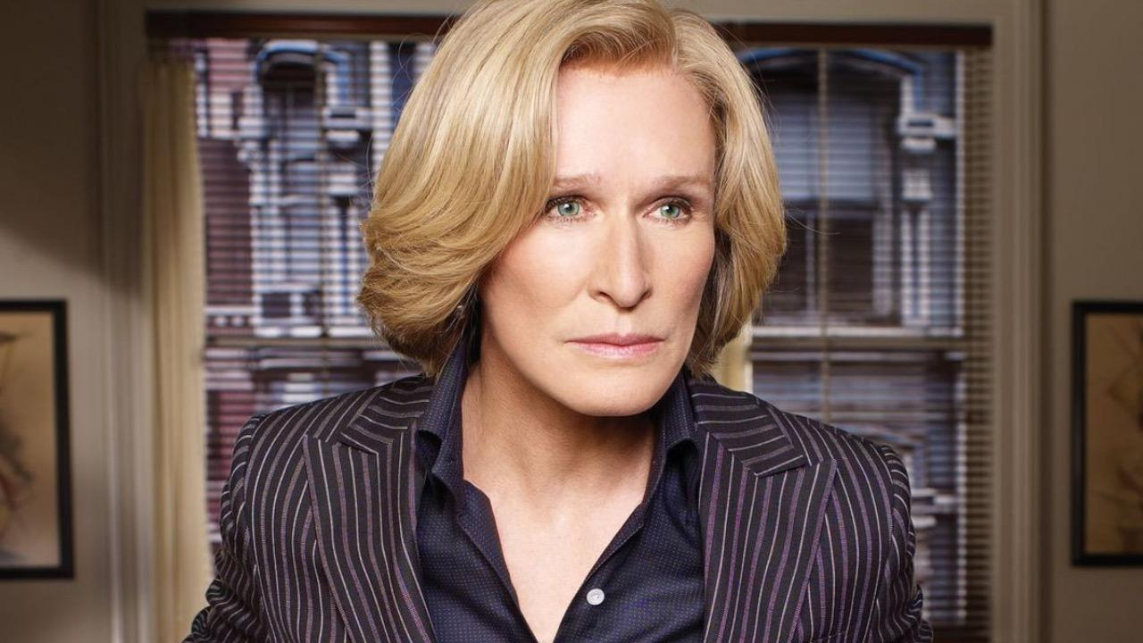
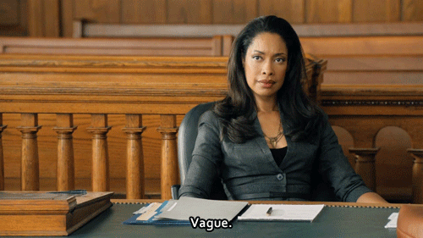

Slide 7
I don’t know

Slide 8
Learning and outcomes
Review and refresh knowledge of Rules of Professional Conduct specifically related to the issue of fairness to all people, regardless of how they appear.
Understanding the relationships between belief and truth and fact in understanding our beliefs
Understanding the concerns about the quality of justice in light of beliefs about how we process information about people based on how they appear.
Learning about steps being taken in Missouri and other jurisdictions in response to concerns about the quality of justice.

Slide 9
Why is it important?
“A lawyer . . .
“A prosecutor . . .
M.R.C.P. 4-8.4(d)
M.R.C.P. 4-8.4(g)

Slide 10
“A Lawyer,
As a member of the legal profession, is . . . A public citizen having special responsibility for the quality of justice.” M.R.P.C. Preamble [1].

Slide 11
“A prosecutor
Has the responsibility of a minister of justice and not simply that of an advocate.” M.R.P.C. 4-3.8 Comment [1].
“is the only one in a criminal action who is responsible for the presentation of the truth. Justice is not complete without the truth always being the primary goal in all criminal proceedings. A prosecutor is not a mere advocate and unlike other lawyers, a prosecutor does not represent individuals or entities, but society as a whole.” NDAA National Prosecution Standards 3rd Ed. Part 1 Sec. 1 Commentary.

Slide 12
M.R.C.P. 4-8.4 Misconduct
It is professional misconduct for a lawyer to:
(d) engage in conduct that is prejudicial to the administration of justice.
(g) manifest by words or conduct, in representing a client, bias or prejudice based on race, sex, religion, national origin, disability, age, or sexual orientation.

Slide 13
Why else is it important?
“It must become the heritage of our Nation to rise above racial classifications that are so inconsistent with our commitment to the equal dignity of all persons.”
“The duty to confront racial animus in the justice system is not the legislature’s alone. Time and again, this Court has been called upon to enforce the Constitution’s guarantee against state-sponsored racial discrimination in the jury system.”
“ . . . discrimination on the basis of race, odious in all aspects, is especially pernicious in the administration of justice.”
“Permitting racial prejudice in the jury system damages both the fact and the perception of the jury’s role as a vital check against the wrongful exercise of power by the State.”
Pena-Rodriguez v. Colorado 137 S.Ct. 855, 867-868 (2017).

Slide 14
We are not built to deal with facts
2 + 2 = 4
17 x 24 = ?
408
Daniel Kahneman, Thinking Fast and Slow p. 20 (2011).

Slide 15
Belief = Truth but Fact ≠ Truth
The Deep Story
“A deep story is a feels-as-if-story – it’s the story feelings tell, in the language of symbols. It removes judgment. It removes fact. It tells us how things feel.” Hochschild, Strangers in Their Own Land: Anger and Mourning on the American Right, p. 135.
If it feels like it is, it is.

Slide 16
Deep Story 1
America is a land of equality where anyone can succeed by pulling themselves up by their boot-straps. All is takes is hard work.

Slide 17
Deep Story 2
“Our [national] commitment [is] to the equal dignity of all persons.”

Slide 18
“It must become the heritage of our Nation to rise above racial classifications that are so inconsistent with our commitment to the equal dignity of all persons.”

Slide 19
“And neither history nor common experience show that the jury system is rife with mischief [like being intoxicated during deliberations or purposefully lying about a pro-defendant bias] or similar kinds.”
“The same cannot be said about racial bias, a familiar and recurring evil that, if left unaddressed, would risk systemic injury to the administration of justice.”

Slide 20
The Problems of Self Reported Fairness
I am fair
I am reasonable
I am unbiased
I am just

Slide 21
The Citizen - Pena Rodriguez v. Colorado
A written questionnaire asked if there was “anything about you that you feel would make it difficult for you to be a fair juror.”
The court repeated the question to the panel of prospective jurors and encouraged jurors to speak in private with the court if they had any concerns about their impartiality.
Defense counsel likewise asked whether anyone felt that “this is simply not a good case” for them to be a fair juror.

Slide 22
Juror H.C.
“I think he did it because he’s Mexican and Mexican men take whatever they want.”
And based on his experience in law enforcement “nine times out of ten Mexican men were guilty of being aggressive toward women and young girls.”
Finally, the defendant’s alibi witness was incredible because he was “an illegal.”

Slide 23
Racism
“They defined as racist a person who uses the “N” word or who “hates” blacks.”
Racism
“As I and others use the term . . . Racism refers to the belief in a natural hierarchy that places blacks at the bottom, and the tendency of whites to judge their own worth by distance from that bottom.”
Hochschild Strangers in Their Own Land p. 146.

Slide 24
The Lawyer – In Re Henry SC95688
Lawyer send email to client’s wife to give to client who was in prison and had just had his habeas petition denied by The Honorable Judge Gaitan.
Lawyer wrote: “. . . it took nearly two years for the puppet nigger Giaten [sic] to write [the decision]. I used to be very racial, but I am not so anymore, but know [sic] and again, I must call a spade a spade.”
Indefinite Suspension for violation of M.R.P.C. 4-8.2(a) and 4-8.4(g)

Slide 25
A Judge – Hon. Richard F. Cebull (Ret.)
The subject line Judge Cebull sent from his official courthouse e-mail address on Feb. 20 at 3:42 p.m., reads: “A MOM’S MEMORY.”
The forwarded text reads:
“Normally I don’t send or forward a lot of these, but even by my standards, it was a bit touching. I want all of my friends to feel what I felt when I read this. Hope it touches your heart like it did mine.
“A little boy said to his mother; ‘Mommy, how come I’m black and you’re white?’” “His mother replied, ‘Don’t even go there Barack! From what I can remember about that party, you’re lucky you don’t bark!’”

Slide 26
Judicial Council of the Ninth Circuit In Re Complaint of Judicial Miscondut Nos. 12-90027
Cebull said he did not write the introduction, but forwarded the e-mail to seven recipients, including his personal e-mail address.
“This is a private thing that was, to say the least, very poor judgment on my part. I did not forward it because of the racist nature of it. Although it is racist, I’m not that way, never have been.”
“There’s no doubt it’s racist. It wasn’t forwarded for that purpose. If anything, it was political.”

Slide 27
A significant number of emails were race related. Whether cast as jokes or serious commentary, the emails showed disdain and disrespect for African Americans, Native Americans and Hispanics, especially those who are not in the United States legally. A similarly significant number of emails related to religion and showed disdain for certain faiths. Approximately the same number of emails concerned women and/or sexual topics and were disparaging of women. A few emails contained inappropriate jokes relating to sexual orientation.
Judge Cebull acknowledged that the February 2012 email was inappropriate, but repeatedly emphasized that he was not biased in court or in his personal attitudes or conduct.
https://cdn.ca9.uscourts.gov/datastore/misconduct/12-90027.pdf

Slide 28
The Judge – Hon. Mark W. Bennett (Ret.)
First, implicit racial bias and other implicit biases exist even, and sometimes particularly, in egalitarian individuals. In fact, such individuals are less likely to be aware of these implicit biases, because they lack explicit biases. I am a prime example. Given my personal relationships and professional background as a former civil rights attorney, I did not consider myself racially biased. You can imagine how shocked I was, after taking my first Black/White Implicit Association Test (IAT) more than a decade ago, to discover I had strong anti-black implicit biases.
Mark W. Bennett, The Implicit Racial Bias in Sentencing: The Next Frontier 126 The Yale Law Journal Forum 391 , 393 January 31, 2017.

Slide 29
“The [IAT] is important because implicit racial preferences often predict behavior and decision-making.”
“Judges, like all vertebrates, have visual blind spots of scotomas (from the Greek word for darkness). We also have cognitive blind spot bias – that is the ability to see bias in others, but not in ourselves. In one study [authors] found that 97% of state court administrative law judges attending an educational conference rated their ability “to avoid racial prejudice in decision-making” in the top half of other judges at the conference. Of course, that is mathematically impossible. The authors worried that “this result means that judges are overconfident about their ability to avoid the influence of race . . . “
Id. at 396

Slide 30
“In my recent national empirical study, I found that 92% of senior federal district judges, 87% of non-senior federal district judges, 72% of U. S. magistrate judges, 77% of federal bankruptcy judges, and 96% of federal probation and pre-trial services officers ranked themselves in the top 25% of respective colleagues in their ability to make decisions free from racial bias. Again, mathematically impossible.” Id.
The only two studies on implicit bias in judges established, unnervingly, that judges . . . have equal or greater implicit biases than members of the general public.” Id. at 398
See also Levinson, Bennett & Hioki, Judging Implicit Bias: A National Empirical Study of Judicial Stereotypes, 69 Fla. L. Rev. 63 (2017).

Slide 31
The Problem of Self Reported Fairness – Coded Language in Jury Selection
Pena Rodriguez –
“fair and impartial”
“Anything about you that you feel would make it difficult for you to be a fair juror.”
Does anyone feel that “this is simply not a good case” for them to be a fair juror?
The Batson Problem –

Slide 32
The Batson Problem
Batson v. Kentucky, 476 U.S. 79 (1986).
The Batson Challenge
Step 1 – Party making the challenge states a prima facie case that the peremptory challenge was race based.
Step 2 – The party exercising the peremptory challenge offers a legitimate race neutral explanation.
Step 3 – Party making the challenge may argue that the explanation is a pretext for discrimination and the judge determines the outcome based on the totality of the circumstances.

Slide 33
The Batson Problem
Batson v. Kentucky, 476 U.S. 79 (1986).
Nor is outright prevarication by prosecutors the only danger here. It is even possible that an attorney may lie to himself in an effort to convince himself that his motives are legal. A prosecutor’s own conscious or unconscious racism may lead him easily to the conclusion that a prospective black juror is “sullen,” or “distant,” a characterization that would not have come to his mind if a white juror had acted identically. A judge’s own conscious or unconscious racism may lead him to accept such an explanation as well supported. Id. at 106 internal quotation and citation deleted (Marshall, J. concurring).

Slide 34
The Batson Problem
Judicial decision-making
Unites States v. Maxwell, 473 F.3d 868, 872 (8th Cir. 2007).
Bell-Bey v. Roper, 499 F.3d 752, 758 (8th Cir. 2007).
Snyder v. Louisiana, 128 S. Ct. 1203, 1208 (2008).
Prosecutorial conduct
Wilson v. Beard, 426 F.3d 653,656 (3rd Cir. 2005).
In Missouri
State v. Washington, 288 S.W.3d 312 (Mo. App. 2009).
State v. Boyd, ___ S.W.3d ___, 2019 WL 6703894 (Mo. App. 2019).

Slide 35
The Batson Problem - Afterword
Hernandez v. New York, 500 U.S. 352 (1991).
Purkett v. Elem, 514 U.S. 765 (1995).
Foster v. Chatman, 136 S.Ct. 1737 (2016).
Flowers v. Mississippi, 139 S. Ct. 2228 (2019).

Slide 36
Responses to the Problems of Self Reporting
Taking the IAT
The ABA “Achieving an Impartial Jury: Addressing Bias in Voir Dire and Deliberations” Project
Washington State General Rule 37
Missouri Approved Instruction (Civil) 2.00(C) and 2.03(A)

Slide 37
Taking the IAT among other things.
“Unquestionably there is a growing awareness of the effects of implicit bias in the legal system. Yet, at a training last year for 500 trial court judges in Florida, fewer than ten responded that they had previously taken an IAT test. That is quite typical of other implicit bias trainings I have done for other courts.” Implicit Racial Bias in Sentencing at p. 397.
Taking multiple IATs
Knowing how the IAT functions and how it is scored
Learning about the numerous studies on IAT and decision-making
Incorporate priming strategies
AIJ Toolbox https://www.americanbar.org/groups/criminal_justice/voir_dire/

Slide 38
Jury Selection
Limiting Peremptory Strikes – Washington General Rule 37
(a) Policy and Purpose. The purpose of this rule is to eliminate the unfair exclusion of potential jurors based on race or ethnicity.
(b) Scope. This rule applies in all jury trials.
(c) Objection. A party may object to the use of a peremptory challenge to raise the issue of improper bias. The court may also raise this objection on its own. The objection shall be made by simple citation to this rule, and any further discussion shall be conducted outside the presence of the panel. The objection must be made before the potential juror is excused, unless new information is discovered.
(d) Response. Upon objection to the exercise of a peremptory challenge pursuant to this rule, the party exercising the peremptory challenge shall articulate the reasons that the peremptory challenge has been exercised.
(e) Determination. The court shall then evaluate the reasons given to justify the peremptory challenge in light of the totality of circumstances. If the court determines that an objective observer could view race or ethnicity as a factor in the use of the peremptory challenge, then the peremptory challenge shall be denied. The court need not find purposeful discrimination to deny the peremptory challenge. The court should explain its ruling on the record.
(f) Nature of Observer. For purposes of this rule, an objective observer is aware that implicit, institutional, and unconscious biases, in addition to purposeful discrimination, have resulted in the unfair exclusion of potential jurors in Washington State.

Slide 39
Jury Selection
(g) Circumstances Considered. In making its determination, the circumstances the court should consider include, but are not limited to, the following:
(i) the number and types of Questions posed to the prospective juror, which may include consideration of whether the party exercising the peremptory challenge failed to Question the prospective juror about the alleged concern or the types of Questions asked about it;
(ii) whether the party exercising the peremptory challenge asked significantly more Questions or different Questions of the potential juror against whom the peremptory challenge was used in contrast to other jurors;
(iii) whether other prospective jurors provided similar answers but were not the subject of a peremptory challenge by that party;
(iv) whether a reason might be disproportionately associated with a race or ethnicity; and
(v) whether the party has used peremptory challenges disproportionately against a given race or ethnicity, in the present case or in past cases.

Slide 40
Jury Selection
(h) Reasons Presumptively Invalid. Because historically the following reasons for peremptory challenges have been associated with improper discrimination in jury selection in Washington State, the following are presumptively invalid reasons for a peremptory challenge;
(i) having prior contact with law enforcement officers;
(ii) expressing a distrust of law enforcement or a belief that law enforcement officers engage in racial profiling;
(iii) having a close relationship with people who have been stopped, arrested, or convicted of a crime;
(iv) living in a high-crime neighborhood;
(v) having a child outside of marriage;
(vi) receiving state benefits; and
(vii) not being a native English speaker.

Slide 41
Jury Selection
(i) Reliance on Conduct. The following reasons for peremptory challenges also have historically been associated with improper discrimination in jury selection in Washington State: allegations that the prospective juror was sleeping, inattentive, or staring or failing to make eye contact; exhibited a problematic attitude, body language, or demeanor; or provided unintelligent or confused answers. If any party intends to offer one of these reasons or a similar reason as the justification for a peremptory challenge, that party must provide reasonable notice to the court and the other parties so the behavior can be verified and addressed in a timely manner. A lack of corroboration by the judge or opposing counsel verifying the behavior shall invalidate the given reason for the peremptory challenge.

Slide 42
The Jurors
Implicit Bias Instruction – Missouri Approved Instruction (Civil) 2.00(C) and 2.03(A) (2020).
Justice depends on careful and fair decisions based on a conscious and unbiased analysis of the evidence in this case. It is the duty of every juror to determine the facts based upon the evidence presented at trial. Automatic or reflexive responses influenced by conscious or unconscious preconceptions or stereotypes should not enter into that determination. Bias based upon factors such as race, sex, gender, gender identity, religion, national origin, ethnicity, disability, age, sexual orientation, or marital status has no role in the pursuit of justice. Your conclusions in this case should be based on a fair and unbiased consideration of the evidence and respect for the views of other jurors whose backgrounds and perspectives may be different from yours.

Slide 43
What does this mean?

Slide 44
Did you say?
Murder Weapon
Image of Love or Admiration or Compassion?
Both?

Slide 49
Psalm 17:8
Keep me as the apple of the eye, hide me under the shadow of thy wings

Slide 51
Thank you!

