Slide 1
Compassionate Release: Federal Sentencing’s Fast-Evolving “Second Look”
And How a BigLaw Firm Can Lead the Way
John Gleeson
Partner, Debevoise & Plimpton LLP
Founder of The Holloway Project
2025 D. Brook Bartlett Lecture
June 27, 2025

Slide 2
Origins of The Holloway Project at Debevoise
July 6, 2016 Killing of Philando Castile Ramsey County, Minnesota
July 5, 2016 Killing of Alton Sterling Baton Rouge, LA

Slide 3
The Holloway Project
Longstanding criminal justice reform initiative representing prisoners (predominantly men of color) serving excessively long sentences resulting from one of the harshest mandatory sentencing provisions in the federal system, which has since been repealed
120+
More than 120 current and former lawyers at Debevoise have represented clients of the Project … and that number is growing
Lawyers
67
The Holloway Project has achieved a substantial reduction in sentence or a full release for 67 total clients.
Wins
2,970
The average reduction in our clients’ sentences is more than 40 years, shaving a total of more than 2,970 years off of their prison time.
Total Years

Slide 4
But the Project Really Goes Back 30 Years
United States v. Francois Holloway – 1995 (E.D.N.Y.) (JG)
Three carjackings in 24 hours; accomplice had handgun
The presence of a firearm gave the prosecutor a choice:
Charge three robbery counts and seek upward adjustment to range (add 3 to 4 years)
- or -
Charge an additional three counts under 18 U.S.C. § 924(c) and add 45 years (5 + 20 + 20)
Beginning in 1998 raised to 57 years (7+25+25)
Holloway’s Plea offer: serve 9 years
Mandatory sentence after trial: 57 years (12+5+20+20)

Slide 5
DOJ’s Racially Discriminatory Invocation of “Stacked” § 924(c) Counts
U.S. Sentencing Commission Reports:
2004: The “Fifteen Year” Report
Black defendants disproportionately subjected to § 924(c) “stacking” for decades.
2011: The “Mandatory Minimum Report”
“Notable demographic differences” continue
Recommends legislative changes to rectify “unwarranted disparities”
2018: The Mandatory Minimums for Firearms Offenses Report
“The impact on Black offenders” even more pronounced: Black offenders accounted for more than 70.5% of offenders convicted of multiple counts under section 924(c).

Slide 6
Why Not Just Reduce It Myself? Finality Reigns!
Parole Was Abolished
Exceptions Are Narrow:
Rule 35 (Clear Error or Substantial Assistance)
Retroactive Amendments to Sentencing Guidelines
Resentencing After Successful Appeal/2255 Motion
“Compassionate Release” (18 U.S.C. § 3582(c)(1)(A))
“Extraordinary and Compelling Reason”
Looks Promising, but …
… BOP is the Gatekeeper

Slide 7
In the Meantime, Calls for a Real Federal “Second Look”
ALI approves § 305.6 of the Model Penal Code in 2011, calling for legislation focused on “Modification of Long-Term Prison Sentences”
Recommended a judicial decisionmaker hear applications for modifications of sentence from defendants who have served at least 15 years of any sentence.
“The prospect of evolving norms, which might render a proportionate prison sentence of one time period disproportionate in the next, is a small worry for prison terms of two, three, or five years, but is of great concern when much longer confinement sentences are at issue.”
In 2016, Charles Colson Task Force on Federal Corrections recommends to Congress to authorize a “second look” for federal prisoners with long sentences, partially inspired by § 305.6 .

Slide 8
Back to Francois Holloway
United States v. Holloway, 95-cr-78 (JG) (2014)
“Order” that is really just a request.
Addresses:
U.S. Attorney Loretta Lynch agrees to vacate two § 924(c) counts
Racial Inequity in DOJ’s use of “Stacking”
Excessive Harshness
Trial Penalty
Finality Not an Insuperable Barrier if Gov’t Agrees

Slide 9
The Opinion
United States v. Holloway, 95-cr-78 (JG) (2014)
“It is easy to be a tough prosecutor. Prosecutors are almost never criticized for being aggressive, or for fighting hard to obtain the maximum sentence, or for saying ‘‘there’s nothing we can do’’ about an excessive sentence after all avenues of judicial relief have been exhausted.”
“It requires a willingness to make hard decisions, including some that will be criticized. This case is a perfect example.”
“Doing justice can be much harder. It takes time and involves work, including careful consideration of the circumstances of particular crimes, defendants, and victims—and often the relevant events occurred in the distant past.”
The opinion circulates like wildfire within BOP

Slide 10
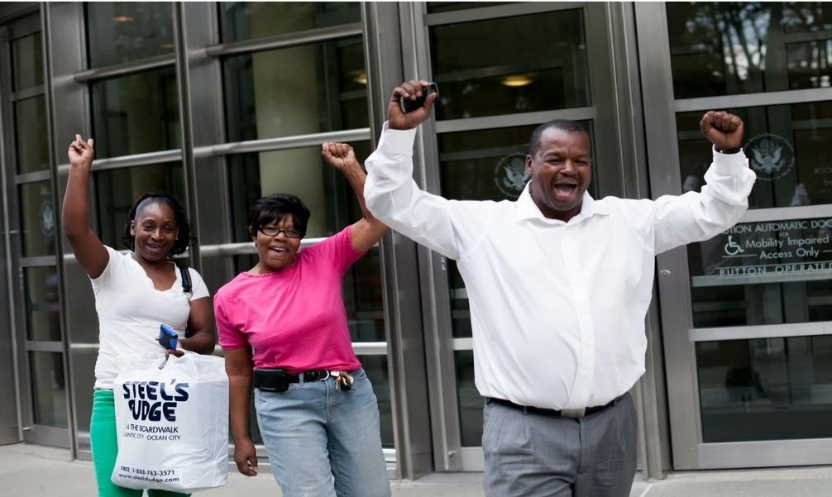
Francois Holloway’s Family Shortly After His Release

Slide 11
Holloway Project: The Supplicant Phase
(Summer 2016 – December 2018)
Try to replicate the Holloway case:
Ask U.S Attorneys to “Do what Loretta did”
No clients granted reductions for two and one-half years, but we continued to fight
Many judges supportive, but DOJ remained hostile
Abject failure

Slide 12
Phase Two: The First Step Act
(December 21, 2018)
Section 403:
Section 603:
Good news: No more “stacking” in first § 924(c) case
Bad news: Not fully retroactive
Amends 18 U.S.C. § 3582(c)(1)(A) (“Compassionate Release Statute”)
Removed BOP as gatekeeper; allowed defendants to file motions after exhausting administrative remedies
“Extraordinary and Compelling Reason” Ground for Reducing “Unusually Long Sentences”

Slide 13
Key Role for the U.S. Sentencing Commission
28 U.S.C. 994(t): The Commission … shall describe what should be considered extraordinary and compelling reasons for sentence reduction, including the criteria to be applied and a list of specific examples. Rehabilitation of the defendant alone shall not be considered an extraordinary and compelling reason.
§1B1.13 (Policy Statement) (pre-First Step) (2007)
Extraordinary and Compelling Reasons are
(A) Medical Condition
(B) Age
(C) Family Circumstances
(D) Other Reasons
The Problem When First Step Enacted: Sentencing Commission Loses Quorum

Slide 14
The Holloway Project’s View: What Could Be More Extraordinary and Compelling?
Grossly excessive sentences
Congress and President Trump Agreed
Didn’t just lower; dramatically lowered: If sentenced post-First Step, there would be gross disparity in mandatory time
Bone Crushing Sentences Invoked in Racially Disparate Fashion
Other Factors:
Age at time of offense
Trial Penalty
Disparity with Co-Defendants
Rehabilitation
Age now (Maturation in Prison; Declining Recidivism Risk)

Slide 15
Litigation Phase One: Successes
(December 2018 – Mid-2022)
Judges hungry to rectify excessive 924(c) sentences
By August 9, 2022, The Holloway Project racked up 39 wins with an average sentence reduction over 36 years
We achieved seminal circuit decisions in:
Federal Defenders and others ride the good case law we helped to develop to get more than 100 other wins
United States v. McCoy
(4th Cir.)
United States v. Maumau
(10th Cir)
United States v. Rose*
(2nd Cir)
*mandatory sentences that would be imposed today do not act as a floor on a sentence reduction motion.

Slide 16
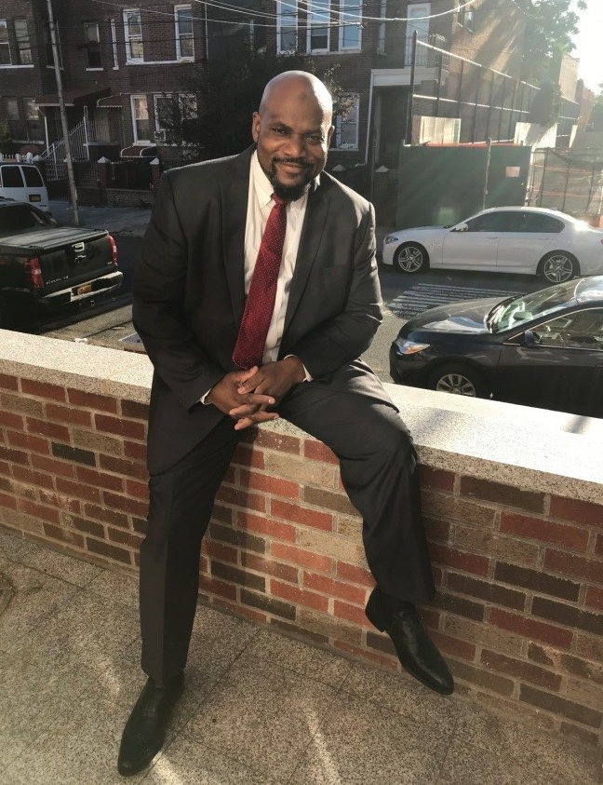
Meet Just a Few of Our First Litigation Phase Clients!
Kevin Haynes Released on April 23, 2020
Ted Davis Released on November 16, 2020
Kittrell Decator Released on April 7, 2020

Slide 17
Circuit Split– Can Judges Consider Nonretroactive Changes in § 924(c) Sentencing Regime an “Extraordinary & Compelling Reason”?
NO
YES
District of Columbia, 3rd, 6th, 7th, 8th
Granting Sentence Reduction is “End Run” Around Congress’ Decision Not to Make Change Retroactive
1st, 2nd, 4th, 5th, 9th, 10th
Relief Under Sentence Reduction Law Isn’t an “End Run”
What they all agreed on (except the 11th Circuit) was there was no applicable guidance from Commission.

Slide 18
DOJ Response to Holloway Project Cert Petitions
(2021-2022)
The Holloway Project files five cert petitions asking the Supreme Court to resolve Circuit Split
Issue: Can the Nonretroactive Change in § 924(c) sentencing regime be considered an “Extraordinary and Compelling Reason” warranting a Sentencing Reduction?
DOJ Cert Oppositions: Don’t resolve the split because the Sentencing Commission should.
“Nobody disputes . . . that the Commission has the power—indeed, the statutory duty – to resolve . . . this particular issue.” Gov. Cert. in Jarvis.
This was in late 2021 and early 2022, when there was no Sentencing Commission to decide anything

Slide 19
The Commission Gets Back in Business
August 2022 President Biden Fills All Seven Commission Seats
Circuit Split is the Commission’s first priority
Influenced to decide it by 994(t) and DOJ position in SCOTUS

Slide 20
Proposed Amendments to 1B1.13 (2023)
Amendments sent to Congress May 1, 2023
Congress had six months to veto or let it become law
Congress doesn’t act—and amendments become effective November 1, 2023
(b)(6) Opens up Previously Closed Circuits

Slide 21
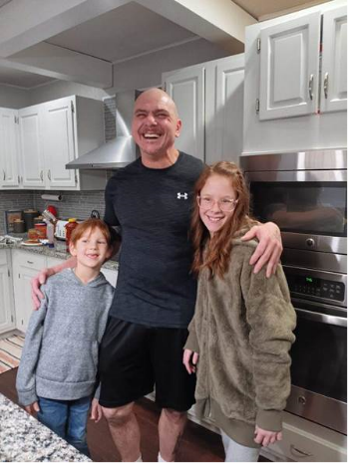
1B1.13(b)(6)
USSC Section 1B1.13(b)(6): “extraordinary and compelling” reasons exist in very narrow circumstances if:
Defendant had an unusually long sentence
Served at least 10 years
“Gross disparity” between sentence imposed and sentence that would likely be imposed today
Dennis Capps (E.D. Mo.)
Reduced mandatory life sentence for one count of possession with intent to distribute methamphetamine to 180 months

Slide 22
1B1.13(b) Other “Extraordinary & Compelling Reasons”
(b)(1) – Medical Circumstances of the Defendant, like terminal illness, serious cognitive impairment, inability to receive specialized medical care while incarcerated, or housing defendant at facility at risk of infection.
(b)(2) – Age of Defendant, at least 65 years old, experiencing a serious deterioration in health due to aging, and has served 10 yrs or 75% of sentence.
Nathaniel Dawson (D. Md.)
Granted motion under both (b)(1) and (b)(2)
At the time of his motion, 85 year old Mr. Dawson had served more than 30 years in prison. Court granted motion due, in part, to Mr. Dawson’s “inability to walk without assistance, his use of a portable oxygen unit, and his multiple serious and chronic medical conditions.”

Slide 23
1B1.13(b) Other “Extraordinary & Compelling Reasons” (cont.)
(b)(4) – Victim of Abuse, defendant, while in custody, is the victim of sexual or physical abuse “committed by, or at the direction of, a correctional officer, an employee or contractor” of BOP.
Abuse must be established by a conviction, admission of liability, or administrative finding (or if administrative proceeding unduly delayed)
Raven Sayers (S.D. Fla)
Experienced months of sexual abuse by an Officer at FCI Tallahassee.
Officer Hatten pled guilty to sexual abuse of a ward, but for abuse of a different woman. Conviction couldn’t be used to establish abuse.
Court granted motion, finding abuse was “established by” undue delay
BOP denied Raven’s two year old administrative claim against Hatten one day before her compassionate release hearing.

Slide 24
1B1.13(b) Other “Extraordinary & Compelling Reasons” (cont.)
(b)(3) – Family Circumstances of Defendant, for example the “incapacitation of the defendant’s parent when the defendant would be the only available caregiver for the parent.”
John Hunter (N.D. Ill.)
Motion granted in May of this year under (b)(3) to care for his ninety-two year old mother, Dorothy.

Slide 25
1B1.13(b) Other “Extraordinary & Compelling Reasons” (cont.)
(b)(5) – Other Reasons, other circumstance or combination of circumstances that, when considered by themselves or together, are similar in gravity to enumerated reasons
Gomeo Rodriguez (S.D. Fla)
Court granted motion based on combination of circumstances, including that “Mr. Rodriguez saved a prison staff member from severe bodily injury when during his UNICOR Federal Prison Industries shift, Mr. Rodriguez put himself in harm’s way to prevent machinery from crushing the staff member’s leg.”

Slide 26
Still an Uphill Battle—DOJ Reverses Course
Amended Commission guidance fits Holloway Project clients like a glove
But now DOJ has new position:
The Commission exceeded its authority by deciding circuit split
“No reasonable interpretation of [extraordinary and compelling], particularly when considered in light of the statute's structure and purpose, can encompass nonretroactive or intervening changes in law. The Commission’s interpretation of the statute as set forth in subsection (b)(6) is unreasonable and therefore invalid.” Br. for the United States in Opp’n, United States v. Allen, 2024 WL 631609, (N.D. Ga. Feb. 12, 2024) (No. 09-cr-320), at 10.

Slide 27
District Judges Calling Out DOJ on It’s Pivot
“
Further, the Government’s argument contradicts itself. The Department of Justice has previously argued that courts should refrain from addressing the retroactivity question because “it should be addressed first by the Commission.” AMENDMENTS TO THE SENTENCING GUIDELINES, supra at 6; see a’s[ [598] at 5 n.11. The Commission has now addressed the issue. How can the Commission have the authority to address the question but exceed that authority by addressing the question? This argument lacks merit.
United States v. Allen, No. 1:09-CR-320-TCB, 2024 WL 631609 at *5 (N.D. Ga. Feb. 12, 2024)(C.J. Batten) Northern District of Georgia

Slide 28
District Judges Calling Out DOJ on It’s Pivot (cont.)
[“The government’s position] makes little sense. …. The simplest explanation for the contradiction, then, is that the government just disagrees with the Commission’s policy choice.
United States v. Harper, No. 04-CR-218 (N.D. Ga. March 11, 2024)
In rejecting the argument: “The government’s position in this case contradicts its previous position that the circuit split should be resolved by the Sentencing Commission.”
United States v. Martinez, 01 CR 564 (D. Utah Feb. 29, 2024)
“
“

Slide 29
Debevoise Associates Argue Against DOJ
The new policy statement increases the demand for arguments for compassionate release
Debevoise associates, counsel, and partners step up to advocate for clients
Since 2016, more than 200 lawyers have spent more than 73,000 hours on Holloway representations. We currently have 49 active district court cases.
16 associates have already argued motions in federal courts; two more arguments next month
New split develops; Supreme Court granted cert this month
But we’re returning clients to families in the meantime

Slide 30
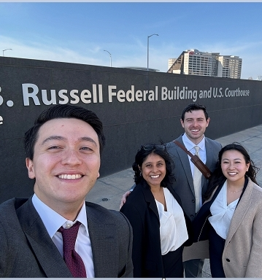
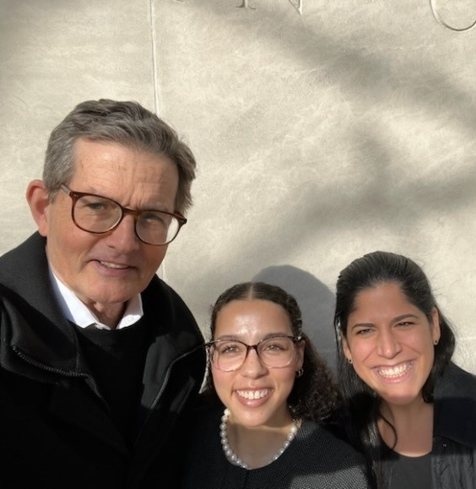
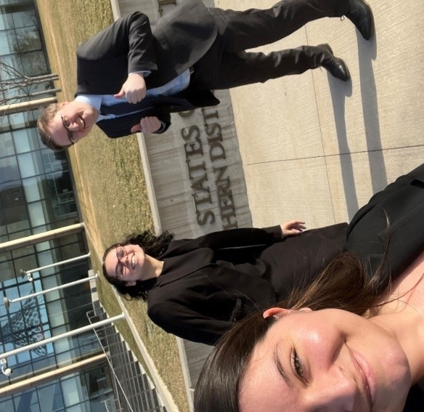
Oral Arguments Around the Country!
All three hearings on the same day, February 26, 2024!
Atlanta, Georgia USA v. Harper
Philadelphia, Pennsylvania USA v. Skeeters
Cedar Rapids, Iowa USA v. Crandall

Slide 31
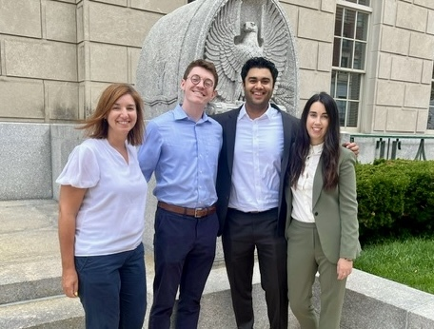
Oral Arguments Around the Country! (cont.)
Peoria, Illinois USA v. Williams
Peoria, Illinois USA v. Thacker

Slide 32
Supreme Court Cert Grants – Rutherford & Carter
Supreme Court recently granted cert in three compassionate release cases: two of which involve stacked 924(c)s:
Carter: 70 years for three bank robberies (Holloway Project case)
Rutherford: 42.5 year sentence for two armed robberies
Rutherford & Carter have been consolidated and present the same issues:
Whether the Sentencing Commission acted within its expressly delegated authority in creating (b)(6); and
Whether a district court may consider disparities created by the First Step Act’s prospective changes in sentencing law when deciding if “extraordinary and compelling reasons” warrant a sentence reduction

Slide 33
Johnnie Carter
Initially charged in 2007 with a single 924(c) count
A second added only after he filed suppression motion
A third added after a mistrial
Sentenced after retrial to 70 years (13 years on underlying robberies, and 57 years on three stacked 924(c) counts) – 29 years old when sentenced
All co-defendants pled guilty: one received a 23-year sentence and the other two received 10-year sentences.
In his 18 years of incarceration, Carter (i) earned his GED, (ii) enrolled in college courses, (iii) mentored fellow inmates, (iv) maintained a perfect disciplinary record for over a decade, (v) stayed connected with his family and got married.
In denying his CR motion after holding argument, the district court noted that Carter’s “remarkable record,” “inspired by his deepened religious faith,” “paint[s] a clear picture of a defendant who . . . does not deserve to spend his life behind bars.”

Slide 34
The Third Supreme Court Cert Grant – Fernandez
S.D.N.Y. granted Fernandez’s compassionate release motion and reduced his sentence to time served, citing his possible innocence and the disparate sentences of his co-conspirators as “extraordinary and compelling” reasons.
Second Circuit reversed, saying possible innocence is not properly raised in a motion for compassionate release.
Question
Whether a combination of extraordinary and compelling reasons can include reasons that may also be alleged as grounds for vacating a sentence?

Slide 35
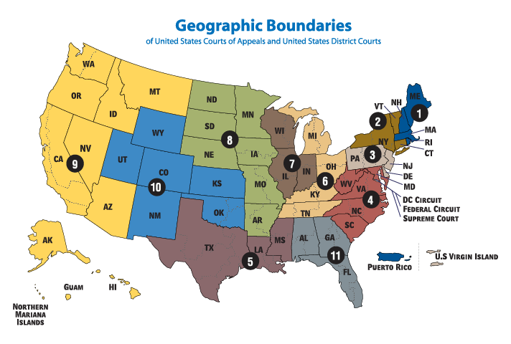
Current Holloway Project Report Card
40
Average Years Reduced
67
Successful
Motions Granted
2,970
Total Years Off Sentences

Slide 36
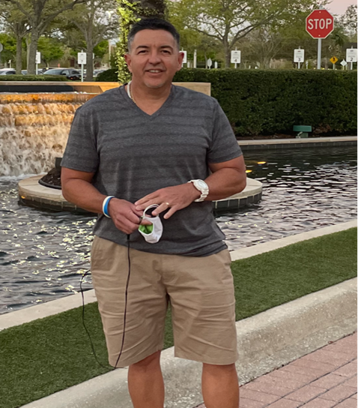
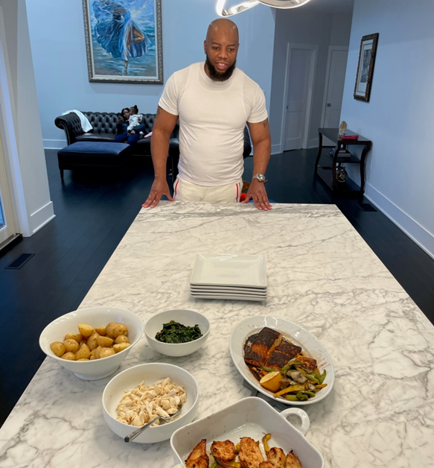
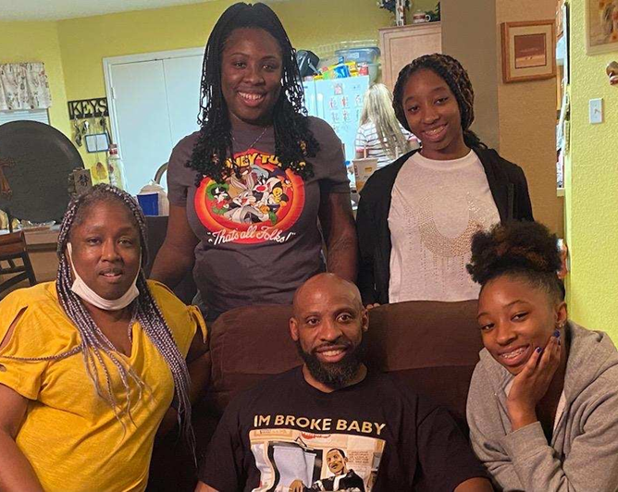
What It’s All About

Slide 37
Holloway Core
Molly Baltimore Maass, Associate
Taylor Booth, Associate
Madeline Moran Silva, Associate
Leah Rosenberg, Associate
Sarah Quirk Smith, Associate
Ardis Strong, Associate
Steven Tegrar, Associate

Slide 38
Thank You
NEW YORK 66 Hudson Boulevard New York, NY 10001 +1 212 909 6000
WASHINGTON, D.C. 801 Pennsylvania Avenue N.W. Washington, D.C. 20004 +1 202 383 8000
SAN FRANCISCO 650 California Street San Francisco, CA 94108 +1 415 738 5700
LONDON The Northcliffe
28 Tudor Street
London
EC4Y 0AY +44 20 7786 9000
PARIS 103 rue de Grenelle 75007 Paris +33 1 40 73 12 12
LUXEMBOURG Debevoise & Plimpton (Luxembourg) SCS Inscrit au Barreau de Luxembourg 4a, rue Albert Borschette L-1246 Luxembourg +352 28 5795 33 00
FRANKFURT Taunustor 1 (Taunus Turm) 60310 Frankfurt am Main +49 69 2097 5000
HONG KONG 21/F AIA Central 1 Connaught Road Central Hong Kong +852 2160 9800
SHANGHAI 13/F, Tower 1 Jing 'an Kerry Centre 1515 Nanjing Road West Shanghai 200040 +86 21 5047 1800

