Slide 1
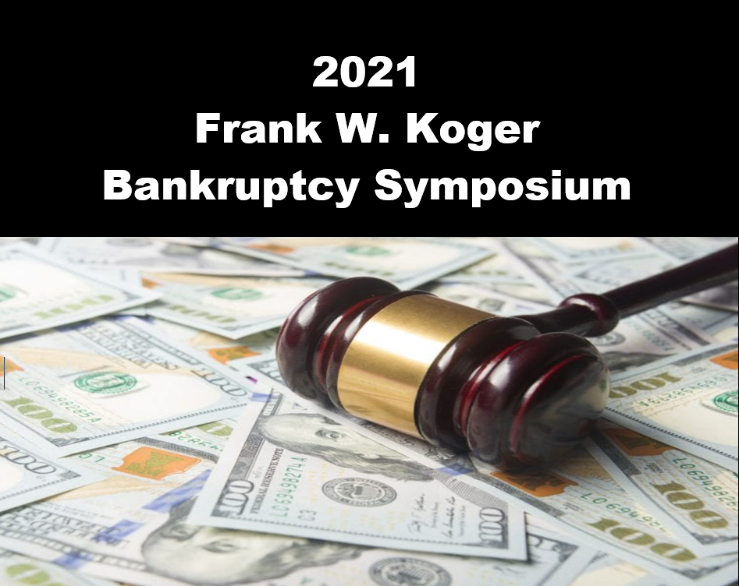

Slide 2
Program Officially Begins 9:00 am Slides contain Program materials & CLE information

Slide 3
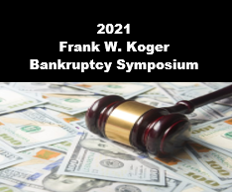
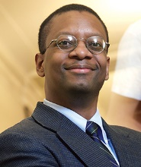
Elephants and Mouseholes in the Code: A Comment on Statutory Interpretation in Bankruptcy
9:00 am - 9:50 am
Troy A. McKenzie
Professor
School of Law - New York University

Slide 4
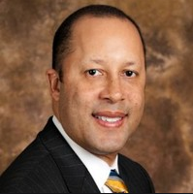
Recognizing and Addressing Implicit Bias in Bankruptcy Proceedings
10:00 am - 10:50 am
The Honorable Christopher M. Alston
U.S. Bankruptcy Judge
Western District of Washington

Slide 5
A Conversation with the Experts
Brian T. Fenimore, Chief, U.S. Bankruptcy Judge Dennis R. Dow, U.S. Bankruptcy Judge Cynthia A. Norton, U.S. Bankruptcy Judge Daniel J. Casamatta, Acting U.S. Trustee Richard V. Fink, Chapter 13 Trustee Sharon L. Stolte, Moderator

Slide 6
Materials Available
https://www.mow.uscourts.gov/outreach
/koger_symposium

Slide 7
Question & Answers
Post questions throughout event
Speakers determines time for questions
Not all questions may be answered due to time

Slide 8
C L E
APPROVED
MO - 3 hours TOTAL CLE
includes 1 hr. Ethics
includes 1 hr. Elimination of Bias
Program ID 680337 (self report)
KS - 3 hours CLE
Affidavit emailed by August 31st
to Zoom verified attendees

Slide 9
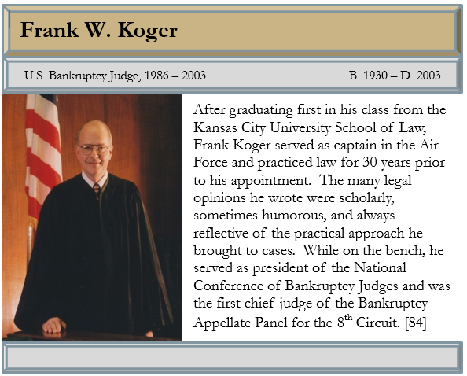
In Memory

Slide 10
Annual Attorney Dues Date Change
Change in 2022!
Last day to pay - February 15, 2022
Please pay timely
Don’t miss invitations to CLE programs!

