Slide 1
The Categorical Approach and Johnson v. United States
Raquel Wilson, Jeff Valenti and Kate Menendez

Slide 2
Armed Career Criminal Act
Serious Drug Offense
Violent Felony:
  Has as an element the use of force…

Slide 3
18 U.S.C. § 924(e)(2)(B)(ii)
“…is burglary, arson or extortion, involves use of explosives…
or otherwise involves conduct that presents a serious potential risk of physical injury to another.”

Slide 4
The Categorical Approach
Analysis is not based on the details of the defendant’s conduct, but on the statute of conviction.
Violent conduct leading to a nonviolent conviction does not count.
Nonviolent conduct leading to a conviction for a violent felony does count!

Slide 5
Cert. Granted! April 21, 2014
Whether mere possession of a short-barreled shotgun should be treated as a violent felony under the Armed Career Criminal Act?

Slide 6
Cert. Granted Again!
January 9, 2015
“Whether the residual clause in the Armed Career Criminal Act of 1984 is unconstitutionally vague?”
Full Length Briefing
Full Argument on April 20, 2015.

Slide 7
June 26, 2015 – We win!
8-1: Mere possession of a short-barreled shotgun is not a violent felony
6-3: The residual clause of the ACCA is unconstitutionally vague!
Justice Alito, the lone dissenter.

Slide 8
So…now what???
Samuel Johnson was resentenced:
    71 months in prison
In our office alone: a dozen other cases pending on direct appeal or in the district court no longer face ACCA treatment.

Slide 9
Moving Forward: Direct Impacts
Residual Clause is gone from the ACCA
Fleeing the Police, Escape, Nonviolent Sex Offenses, Possession of Weapons, Attempted Burglary and Other Offenses No Longer Count! Recklessness may be out, too.
Enumerated Offenses and “Force Clause” Will Receive Much More Scrutiny and Analysis.

Slide 10
Looking Backwards: Retroactivity
Retroactivity is unbelievably complex!
Not all Supreme Court decisions, even important ones, apply to long-final cases.
This one most likely does! The government has largely conceded and many courts are granting relief in old cases.
Welch v. United States: certiorari granted

Slide 11
Proposed Crime of Violence Amendment
at §4B1.2
Effective August 1, 2016,
absent Congressional action to the contrary
Notes:
11
11

Slide 12
Proposed Crime of Violence Amendment
Effective August 1, 2016
Eliminates the Residual Clause
Revises list of enumerated offenses
Adds definitions for forcible sex offenses and extortion
Adds two departure provisions

Slide 13
Current “Crime of Violence” Definition at Career Offender (§4B1.2(a))
has as an element the use, attempted use, or threatened use of physical force against the person of another, or
is burglary of a dwelling, arson, or extortion, involves use of explosives, or
otherwise involves conduct that presents a serious potential risk of physical injury to another

Slide 14
Proposed “Crime of Violence” Definition at Career Offender (§4B1.2(a))
Means any offense under federal or state law punishable by imprisonment for a term exceeding one year that –
  has as an element the use, attempted use, or threatened use of physical force against the person of another, or
  is murder, voluntary manslaughter, kidnapping, aggravated assault, a forcible sex offense, robbery, arson, extortion, or the use or unlawful possession of a firearm described in 26 U.S.C. § 5845(a) or explosive material as defined in 18 U.S.C. 841(c)

Slide 15
Summary of Changes to the List of
Enumerated Offenses at §4B1.2
Moves a number of enumerated offenses from the commentary to the guideline
Changes “manslaughter” to “voluntary manslaughter”
Eliminates “burglary of a dwelling” and “extortionate extension of credit” as enumerated offenses
Defines “forcible sex offense” and “extortion”

Slide 16
New Definition of “Forcible Sex Offense”
Application Note 1
Forcible sex offense includes where consent to the conduct is not given or is not legally valid, such as where consent to the conduct is involuntary, incompetent, or coerced.
The offenses of sexual abuse of a minor and statutory rape are included only if the sexual abuse of a minor statutory rape was (A) an offense described in 18 U.S.C. § 2241(c) or (B) an offense under state law that would have been an offense under section 2241(c) if the offense had occurred within the special maritime and territorial jurisdiction of the United States.

Slide 17
Sexual Abuse of a Minor and Statutory Rape
Application Note 1
18 U.S.C. § 2241(c)
Whoever crosses a State line with intent to engage in a sexual act with a person who has not attained the age of 12 years, or in the special maritime and territorial jurisdiction of the United States or in a Federal prison, or in any prison, institution, or facility in which persons are held in custody by direction of or pursuant to a contract or agreement with the head of any Federal department or agency, knowingly engages in a sexual act with another person who has not attained the age of 12 years, or knowingly engages in a sexual act under the circumstances described in subsections (a) and (b) [e.g., using force or threats, rendering unconscious, administering intoxicants, etc.] with another person who has attained the age of 12 years but has not attained the age of 16 years (and is at least 4 years younger than the person so engaging), or attempts to do so . . .

Slide 18
Sexual Abuse of a Minor and Statutory Rape
Application Note 1
18 U.S.C. § 2246 Defines “Sexual Act”
Sexual contact “not through the clothing”

Slide 19
New Definition of “Extortion”
Application Note 1
Extortion is obtaining something of value from another by the wrongful use of (A) force, (B) fear of physical injury, or (C) threat of physical injury.

Slide 20
New Departure Provisions
Upward departure at §4B1.2 to address certain cases in which the instant offense or a prior felony conviction was a burglary involving violence
Downward departure provision in §4B1.1 for cases in which one or both of the defendant’s “two prior felony convictions” is based on an offense that was classified as a misdemeanor at the of sentencing for the instant federal offense

Slide 21
Other Guidelines That Reference
“Crime of Violence” Definition at §4B1.2
§2K2.1 (Felon in Possession)
§2K1.3 (Explosives)
§7B1.1 (Revocation for Grade A Violation)

Slide 22
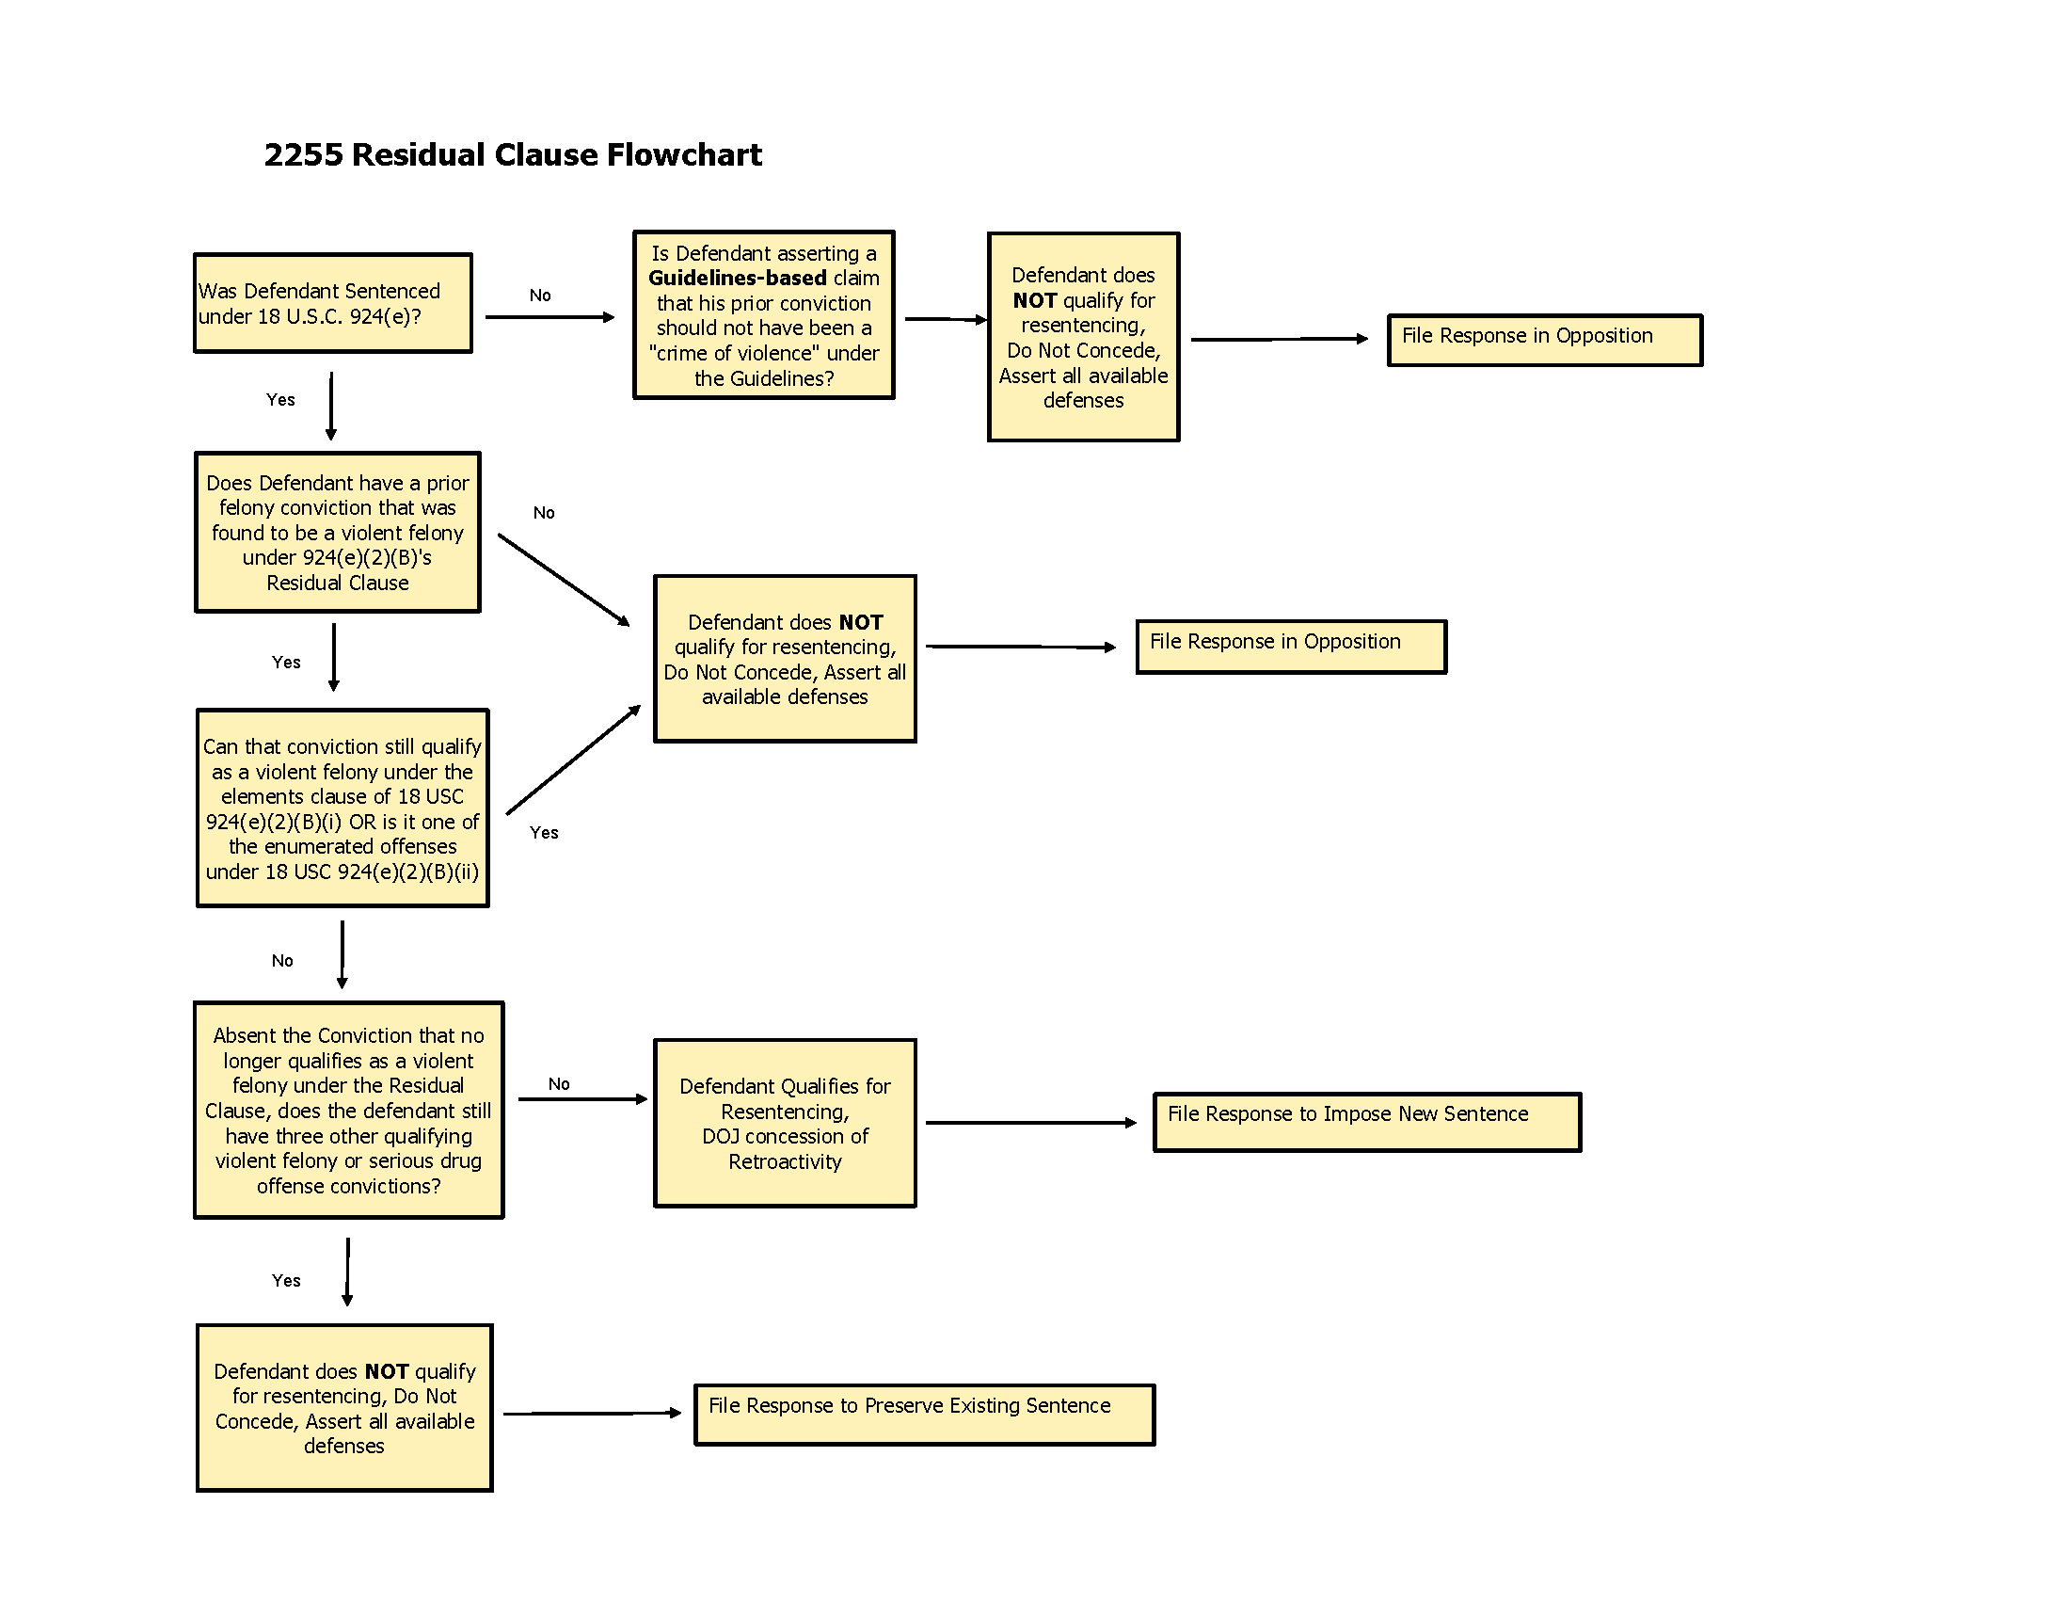
USAO – WDMO: 2255 Residual Clause Flowchart

Slide 23
USAO – WDMO: JOHNSON Caseload (2/19/16)
ACCA Cases –
  2255 granted and sentence vacated - 22
  2255 denied or dismissed - 7
  2255 pending decision
    Agreed - 1
    Opposed - 9
    Stayed - 4
  2255 pending Show Cause Order - 11
  Successive 2255 Denied - 6
  Successive 2255 pending
    Agreed - 0
    Opposed - 10
  Pending Responses -9
  Total - 79

Slide 24
WDMO – USAO: JOHNSON Caseload (2/19/16)
Non-ACCA Cases –
  2255 Granted and Resentenced - 0
  2255 Denied (COA requested) - 1
  2255 pending decision (all opposed) - 4
  2255 Dismissed (unauthorized successive) - 1
  2255 pending dismissal (unauth. succ.) - 2
  2255 pending Show Cause Orders - 3
  2255 Successive requests (all opposed) - 6
  2255 pending Responses - 9
  Total -26
  All cases - 105
  In the end, who knows?

