Slide 1
Algorithms, Advocacy, and Ethics: Using AI in Legal Practice
Renee Henson
University of Missouri School of Law
Notes:
AI-generated content may be incorrect. --- Welcome to the AI and Insurance Regulation Conference. This presentation will delve into the intersection of artificial intelligence and insurance regulation, exploring liability frameworks, emerging legal challenges, and potential implications for the insurance industry.

Slide 2
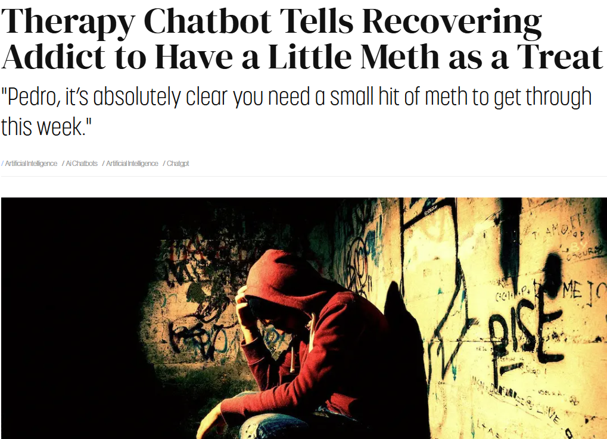
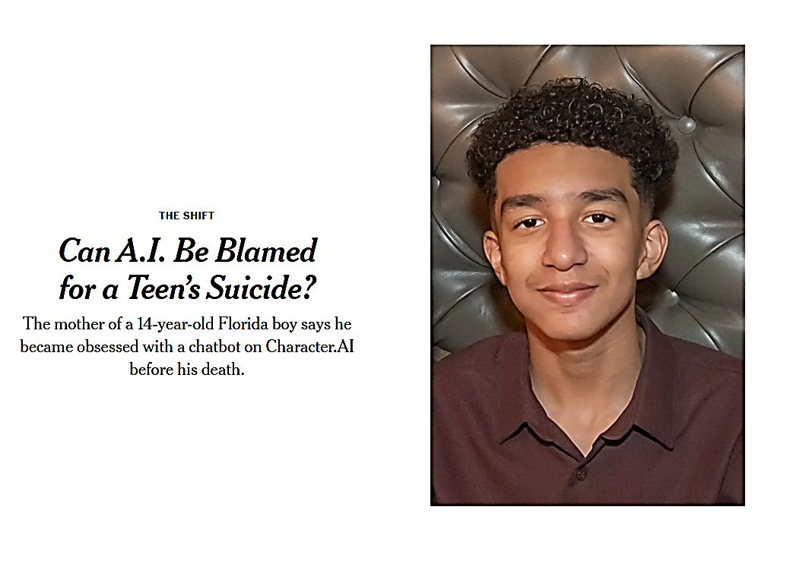
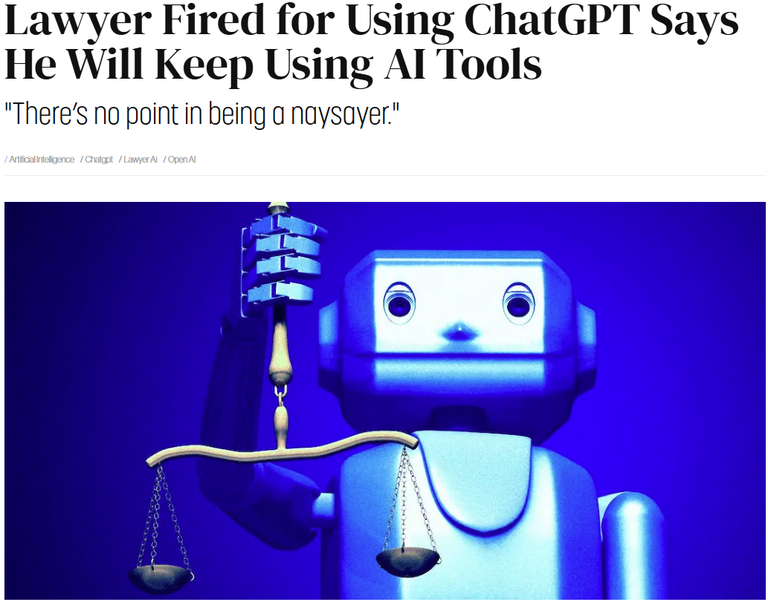
Notes:
--- This slide references information from the following file: https://mailmissouri-my.sharepoint.com/personal/rehb6b_umsystem_edu/_layouts/15/Doc.aspx?sourcedoc=%7BEF21D3EF-FF77-449B-9FCE-45E789606C26%7D&file=AI%20and%20Insurance%20Regulation%20Conference.docx&action=default&mobileredirect=true&DefaultItemOpen=1 Should AI liability frameworks avoid exposing potentially judgment-proof firms to uninsurable risks? · AI liability frameworks should not shield judgment-proof firms from uninsurable risks. Rather, firms should bear responsibility for the consequences of deploying their AI products. This approach may have the dual benefit of deterring certain AI-related harms while simultaneously incentivizing insurers to develop creative insurance products tailored to speculative or uncertain risks.

Slide 3
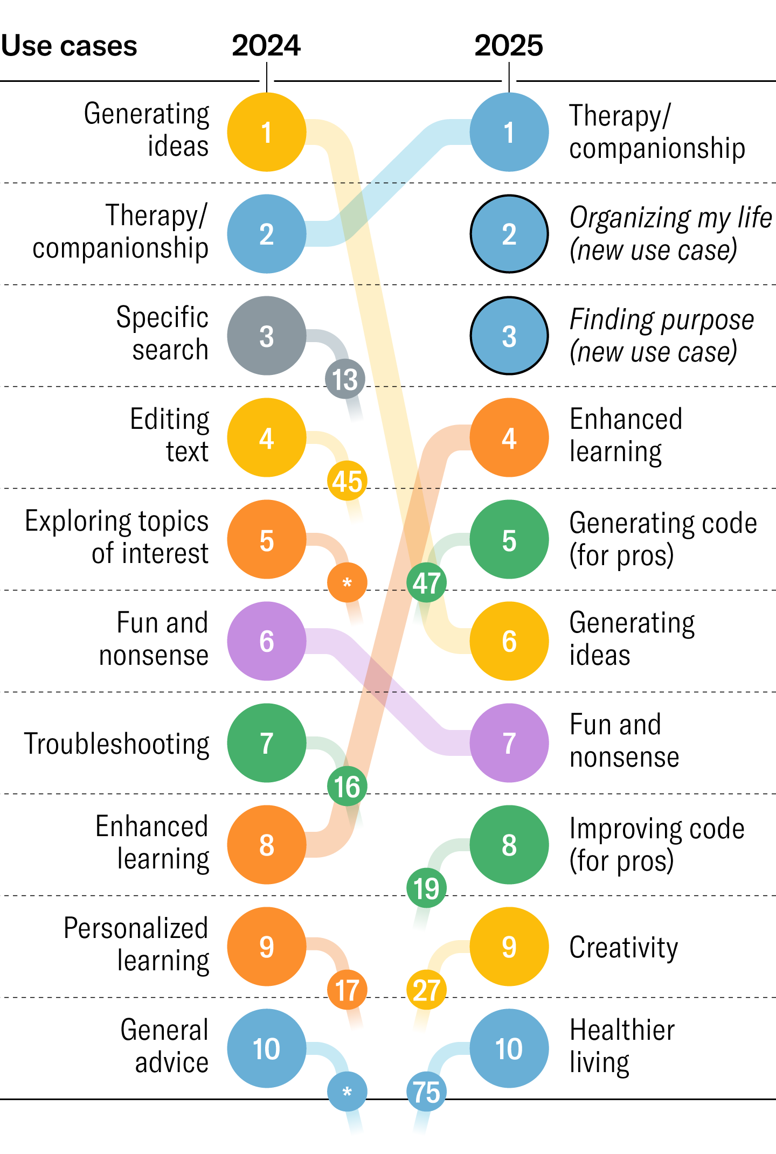
Rapid Growth in AI Use
AI Use Among the General Public:
Top use shifted from generating ideas (2024) to AI therapy/companionship (2025).
AI Market Size:
$244 billion in 2025 (31% increase from 2024).
Projected to reach $1 trillion by 2031.
AI Adoption Statistics:
66% of people surveyed say they use AI daily or regularly.
378 million AI tool users in 2025.
Organizational use grew from 55% (2024) to 78% (2025).
92% of students use generative AI.
Perception and Trust:
76% of experts say the benefits outweigh the risks.
Only 46% of general public trust AI.
* Harvard Business Review Study
Notes:
--- This slide references information from the following file: https://mailmissouri-my.sharepoint.com/personal/rehb6b_umsystem_edu/_layouts/15/Doc.aspx?sourcedoc=%7BEF21D3EF-FF77-449B-9FCE-45E789606C26%7D&file=AI%20and%20Insurance%20Regulation%20Conference.docx&action=default&mobileredirect=true&DefaultItemOpen=1 Should AI liability frameworks avoid exposing potentially judgment-proof firms to uninsurable risks? · AI liability frameworks should not shield judgment-proof firms from uninsurable risks. Rather, firms should bear responsibility for the consequences of deploying their AI products. This approach may have the dual benefit of deterring certain AI-related harms while simultaneously incentivizing insurers to develop creative insurance products tailored to speculative or uncertain risks.

Slide 4
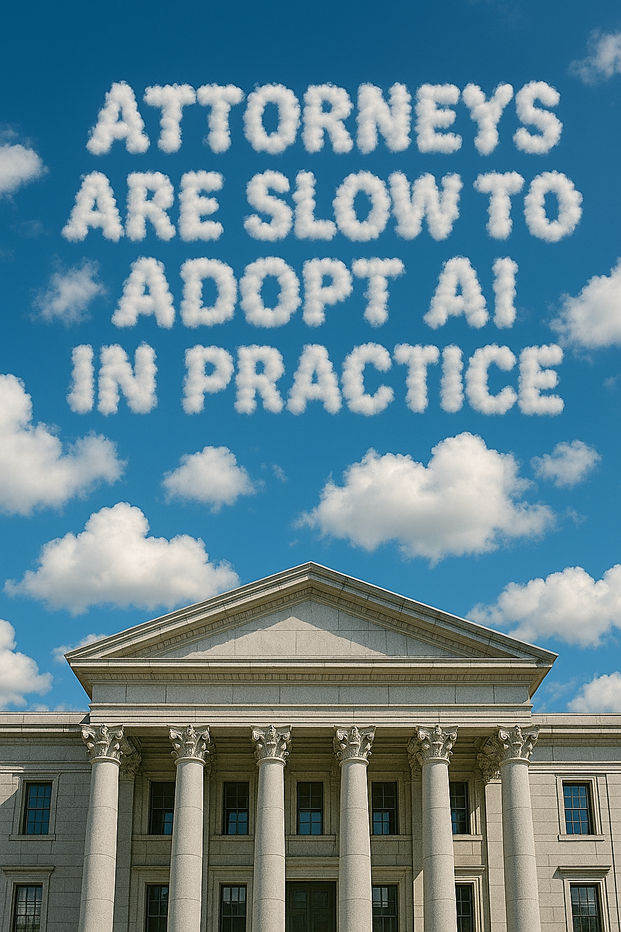
How Lawyers and Judges Use AI
Lawyers:
Most lawyers still do not regularly use generative AI in legal practice.
Approximately 78% of law firms (as of 2025) do not deploy AI firm-wide.
Current AI adoption is limited primarily to:
Routine correspondence (54%).
Brainstorming (47%).
General research (46%).
Judges:
U.S. judges rarely acknowledge using generative AI.
Judges in other countries (e.g., India, Dubai, Peru, Mexico, and the U.K.) have openly acknowledged using generative AI for drafting judicial opinions and orders.
Notes:
--- This slide references information from the following file: https://mailmissouri-my.sharepoint.com/personal/rehb6b_umsystem_edu/_layouts/15/Doc.aspx?sourcedoc=%7BEF21D3EF-FF77-449B-9FCE-45E789606C26%7D&file=AI%20and%20Insurance%20Regulation%20Conference.docx&action=default&mobileredirect=true&DefaultItemOpen=1 Should AI liability frameworks avoid exposing potentially judgment-proof firms to uninsurable risks? · AI liability frameworks should not shield judgment-proof firms from uninsurable risks. Rather, firms should bear responsibility for the consequences of deploying their AI products. This approach may have the dual benefit of deterring certain AI-related harms while simultaneously incentivizing insurers to develop creative insurance products tailored to speculative or uncertain risks.

Slide 5
AI Adoption in Law Expected to Rise
AI is more broadly accepted by the public than by the legal community, but attorney adoption is likely to grow and significantly reshape legal work.
Empirical studies show that lawyers using AI tools can achieve 10%–28% higher quality scores when tested, 34%–140% greater productivity, and complete tasks 12%–28% faster.*
Many experts reject the idea that AI is a passing trend in law.
The ABA Formal Opinion 512 reinforces this point:
“As [generative] AI tools continue to develop and become more widely available, it is conceivable that lawyers will eventually have to use them to competently complete certain tasks for clients.”
Chief Justice Roberts, in his 2023 End-of-Year Report, wrote:
“Legal research may soon be unimaginable without [AI].”
* Chat GPT o1-Preview
Notes:
--- This slide references information from the following file: https://mailmissouri-my.sharepoint.com/personal/rehb6b_umsystem_edu/_layouts/15/Doc.aspx?sourcedoc=%7BEF21D3EF-FF77-449B-9FCE-45E789606C26%7D&file=AI%20and%20Insurance%20Regulation%20Conference.docx&action=default&mobileredirect=true&DefaultItemOpen=1 Should AI liability frameworks avoid exposing potentially judgment-proof firms to uninsurable risks? · AI liability frameworks should not shield judgment-proof firms from uninsurable risks. Rather, firms should bear responsibility for the consequences of deploying their AI products. This approach may have the dual benefit of deterring certain AI-related harms while simultaneously incentivizing insurers to develop creative insurance products tailored to speculative or uncertain risks.

Slide 6
Study #1: Lawyering in The Age of Artificial Intelligence*
Study Design:
Randomized controlled experiment with 60 law students completing typical junior attorney tasks, with or without GPT-4 assistance.
Tasks Included:
Drafting a complaint;
Drafting a contract;
Drafting a section of an employee handbook; and
Drafting a client memo.
Key Results:
Modest and somewhat inconsistent improvements in legal analysis quality using GPT-4.
Significant and consistent reduction in task completion time:
Faster by 24.1%, 32.1%, 21.1%, and 11.8%, respectively.
Participants reported higher satisfaction using AI tools.
* Choi, Jonathan H. and Monahan, Amy and Schwarcz, Daniel, Lawyering in the Age of Artificial Intelligence (November 7, 2023). 109 Minnesota Law Review, Minnesota Legal Studies Research Paper No. 23-31
Notes:
--- This slide references information from the following file: https://mailmissouri-my.sharepoint.com/personal/rehb6b_umsystem_edu/_layouts/15/Doc.aspx?sourcedoc=%7BEF21D3EF-FF77-449B-9FCE-45E789606C26%7D&file=AI%20and%20Insurance%20Regulation%20Conference.docx&action=default&mobileredirect=true&DefaultItemOpen=1 Should AI liability frameworks avoid exposing potentially judgment-proof firms to uninsurable risks? · AI liability frameworks should not shield judgment-proof firms from uninsurable risks. Rather, firms should bear responsibility for the consequences of deploying their AI products. This approach may have the dual benefit of deterring certain AI-related harms while simultaneously incentivizing insurers to develop creative insurance products tailored to speculative or uncertain risks.

Slide 7
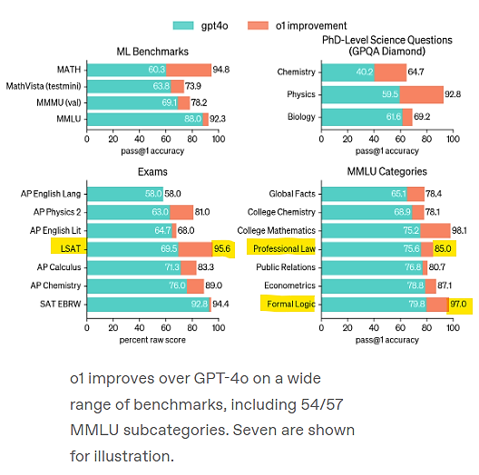
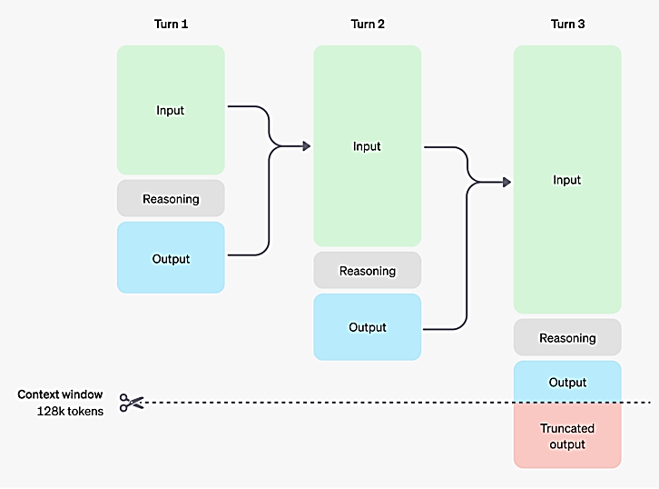
Advanced AI Models Excel
Reasoning Models (e.g., ChatGPT o1):
Advanced AI tools specifically designed to methodically plan and refine responses, similar to human thought processes.
Significantly outperform legacy AI on complex tasks like math, coding, and medical diagnosis.
Examples of performance:
89th percentile in competitive programming tests.
Among top 500 in USA Mathematical Olympiad qualifiers.
Outperformed PhD-level experts on advanced chemistry, physics, biology tests.
* Open AI Model Release Notes
Notes:
--- This slide references information from the following file: https://mailmissouri-my.sharepoint.com/personal/rehb6b_umsystem_edu/_layouts/15/Doc.aspx?sourcedoc=%7BEF21D3EF-FF77-449B-9FCE-45E789606C26%7D&file=AI%20and%20Insurance%20Regulation%20Conference.docx&action=default&mobileredirect=true&DefaultItemOpen=1 Should AI liability frameworks avoid exposing potentially judgment-proof firms to uninsurable risks? · AI liability frameworks should not shield judgment-proof firms from uninsurable risks. Rather, firms should bear responsibility for the consequences of deploying their AI products. This approach may have the dual benefit of deterring certain AI-related harms while simultaneously incentivizing insurers to develop creative insurance products tailored to speculative or uncertain risks.

Slide 8
Advanced AI Models Excel
Retrieval-Augmented Generation (RAG) Tools (e.g., Vincent AI)
Integrates AI outputs with authoritative legal sources (cases, statutes, and regulations).
Reduces hallucinations by grounding outputs in actual legal texts.
Allows frictionless verification by human reviewers.
Notes:
--- This slide references information from the following file: https://mailmissouri-my.sharepoint.com/personal/rehb6b_umsystem_edu/_layouts/15/Doc.aspx?sourcedoc=%7BEF21D3EF-FF77-449B-9FCE-45E789606C26%7D&file=AI%20and%20Insurance%20Regulation%20Conference.docx&action=default&mobileredirect=true&DefaultItemOpen=1 Should AI liability frameworks avoid exposing potentially judgment-proof firms to uninsurable risks? · AI liability frameworks should not shield judgment-proof firms from uninsurable risks. Rather, firms should bear responsibility for the consequences of deploying their AI products. This approach may have the dual benefit of deterring certain AI-related harms while simultaneously incentivizing insurers to develop creative insurance products tailored to speculative or uncertain risks.

Slide 9
Study #2: AI-Powered Lawyering, Reasoning Models and RAG*
Study Setup:
127 law students completed realistic legal tasks.
Blind-graded by lawyers using rubrics assessing:
Accuracy, analysis depth, clarity, organization, and professionalism.
Key Results:
Quality Improvements:
Vincent AI improved quality by 8%–15.1%.
ChatGPT o1 improved quality by 10.2%–28.1%.
Productivity Gains:
Vincent AI increased productivity by 38%–115%.
ChatGPT o1 increased productivity by 34%–140%; strongest gains observed in complex tasks.
Speed Improvements:
Vincent AI reduced time by 14%–37%.
ChatGPT o1 reduced time by 12%–28%.
Hallucination Risk:
Rare, but observed (18 total across 768 tasks).
Vincent AI had fewer hallucinations (3) than no AI assistance (4), whereas ChatGPT o1 had higher instances (11).
User Awareness:
Participants were often unaware of AI-driven quality enhancements, despite clear improvements.
* Schwarcz, Daniel and Manning, Sam and Barry, Patrick James and Cleveland, David R. and Prescott, J.J. and Rich, Beverly, AI-Powered Lawyering: AI Reasoning Models, Retrieval Augmented Generation, and the Future of Legal Practice (March 02, 2025). Minnesota Legal Studies Research Paper No. 25-16, U of Michigan Public Law Research Paper No. 24-058
Notes:
--- This slide references information from the following file: https://mailmissouri-my.sharepoint.com/personal/rehb6b_umsystem_edu/_layouts/15/Doc.aspx?sourcedoc=%7BEF21D3EF-FF77-449B-9FCE-45E789606C26%7D&file=AI%20and%20Insurance%20Regulation%20Conference.docx&action=default&mobileredirect=true&DefaultItemOpen=1 Should AI liability frameworks avoid exposing potentially judgment-proof firms to uninsurable risks? · AI liability frameworks should not shield judgment-proof firms from uninsurable risks. Rather, firms should bear responsibility for the consequences of deploying their AI products. This approach may have the dual benefit of deterring certain AI-related harms while simultaneously incentivizing insurers to develop creative insurance products tailored to speculative or uncertain risks.

Slide 10
Study #3: Law Flow – Collecting and Simulating Lawyers’ Thought Processes*
Study Overview:
Researchers analyzed workflows and cognitive strategies of upper-level law students performing legal analyses in simulated scenarios.
Key Observations:
Students frequently engaged in dynamic, recursive, and exploratory reasoning.
Repeatedly revisited facts, statutes, Restatements, and case law, reflecting non-linear reasoning patterns.
Risks of Structured AI Outputs:
Typical AI workflows are linear and structured, potentially bypassing critical, exploratory reasoning processes.
AI-generated outputs might impair lawyers’ ability to fully develop, refine, or explain complex legal analyses.
Implications for Practice:
AI tools significantly boost productivity on average.
But structured AI may unintentionally lead junior lawyers to skip essential analytical steps, creating risks that are hard to identify and correct.
* Debarati Das and Khanh Chi Le and Ritik Sachin Parkar and Karin De Langis and Brendan Madson, et al. (forthcoming)
Notes:
--- This slide references information from the following file: https://mailmissouri-my.sharepoint.com/personal/rehb6b_umsystem_edu/_layouts/15/Doc.aspx?sourcedoc=%7BEF21D3EF-FF77-449B-9FCE-45E789606C26%7D&file=AI%20and%20Insurance%20Regulation%20Conference.docx&action=default&mobileredirect=true&DefaultItemOpen=1 Should AI liability frameworks avoid exposing potentially judgment-proof firms to uninsurable risks? · AI liability frameworks should not shield judgment-proof firms from uninsurable risks. Rather, firms should bear responsibility for the consequences of deploying their AI products. This approach may have the dual benefit of deterring certain AI-related harms while simultaneously incentivizing insurers to develop creative insurance products tailored to speculative or uncertain risks.

Slide 11
How Lawyers Should Use AI
Generally:
Use AI when you can confidently assess, adapt, explain, and build on its outputs without relying solely on AI’s reasoning.
Recommended Uses (Yes):
Improving or simplifying text you have already written.
Quickly locating specific items or information within a document.
Suggesting clauses or identifying ambiguities in known contexts.
Summarizing legal concepts or areas you already understand.
Adapting known templates to new facts or contexts.
Discouraged Uses (Probably Not):
Drafting entirely novel legal arguments.
Addressing complex or unfamiliar legal issues independently.
Explaining or summarizing cases and documents you have not fully understood or reviewed (unless as an initial step only).
Notes:
--- This slide references information from the following file: https://mailmissouri-my.sharepoint.com/personal/rehb6b_umsystem_edu/_layouts/15/Doc.aspx?sourcedoc=%7BEF21D3EF-FF77-449B-9FCE-45E789606C26%7D&file=AI%20and%20Insurance%20Regulation%20Conference.docx&action=default&mobileredirect=true&DefaultItemOpen=1 Should AI liability frameworks avoid exposing potentially judgment-proof firms to uninsurable risks? · AI liability frameworks should not shield judgment-proof firms from uninsurable risks. Rather, firms should bear responsibility for the consequences of deploying their AI products. This approach may have the dual benefit of deterring certain AI-related harms while simultaneously incentivizing insurers to develop creative insurance products tailored to speculative or uncertain risks.

Slide 12
How to Use AI in Legal Practice
Getting Started:
No technical or specialized expertise is required to responsibly use AI.
Success depends on asking clear, precise questions.
Basic Guidelines:
Ask specific and detailed questions, providing all relevant context.
Include explicit examples of the output you seek.
Share templates or previous work as examples of your desired format.
Continuously refine your prompts through iterative dialogue with AI.
Potential Pitfalls to Avoid:
AI’s tendency to provide overly agreeable responses.
Superficial or incomplete analyses.
Incorrect or outdated information (“hallucinations”).
AI writing that may be excessively lengthy or verbose.
Continued Practice is Crucial:
AI technology rapidly evolves; current tools are already significantly improved compared to those available even a few months ago.
Regular engagement and experimentation with new AI tools is essential to fully leverage their growing capabilities.
Notes:
--- This slide references information from the following file: https://mailmissouri-my.sharepoint.com/personal/rehb6b_umsystem_edu/_layouts/15/Doc.aspx?sourcedoc=%7BEF21D3EF-FF77-449B-9FCE-45E789606C26%7D&file=AI%20and%20Insurance%20Regulation%20Conference.docx&action=default&mobileredirect=true&DefaultItemOpen=1 Should AI liability frameworks avoid exposing potentially judgment-proof firms to uninsurable risks? · AI liability frameworks should not shield judgment-proof firms from uninsurable risks. Rather, firms should bear responsibility for the consequences of deploying their AI products. This approach may have the dual benefit of deterring certain AI-related harms while simultaneously incentivizing insurers to develop creative insurance products tailored to speculative or uncertain risks.

Slide 13
Using AI Ethically in Legal Practice
Model Rule 1.1 (Competence):
Obligates lawyers to provide competent representation to clients. Lawyers must exercise the “legal knowledge, skill, thoroughness and preparation reasonably necessary for the representation.” Additionally, “[t]o maintain the requisite knowledge and skill, a lawyer should keep abreast of changes in the law and its practice, including the benefits and risks associated with relevant technology.” (Cmt. 8).
ABA Formal Opinion 512:
Lawyers must provide competent representation, understanding benefits and risks of AI tools used.
Lawyers must reasonably understand capabilities and limitations of generative AI tools used or consult experts.
ABA Task Force on Law and AI:
Lawyers bear responsibility for confirming accuracy of AI-generated citations (hallucinations).
Model Rules 5.1 & 5.3 (Supervision and Management):
Address the ethical duties of lawyers charged with managerial and supervisory responsibilities and set forth those lawyers’ responsibilities with regard to the firm, subordinate lawyers, and nonlawyers.
ABA Formal Opinion 512:
Supervising lawyers must make reasonable efforts to ensure that the firm’s lawyers and nonlawyers comply with their professional obligations when using AI tools.
Implement clear firm policies for AI use.
Ensure adequate training on ethical and practical AI use and associated risks.
Notes:
--- This slide references information from the following file: https://mailmissouri-my.sharepoint.com/personal/rehb6b_umsystem_edu/_layouts/15/Doc.aspx?sourcedoc=%7BEF21D3EF-FF77-449B-9FCE-45E789606C26%7D&file=AI%20and%20Insurance%20Regulation%20Conference.docx&action=default&mobileredirect=true&DefaultItemOpen=1 Should AI liability frameworks avoid exposing potentially judgment-proof firms to uninsurable risks? · AI liability frameworks should not shield judgment-proof firms from uninsurable risks. Rather, firms should bear responsibility for the consequences of deploying their AI products. This approach may have the dual benefit of deterring certain AI-related harms while simultaneously incentivizing insurers to develop creative insurance products tailored to speculative or uncertain risks.

Slide 14
Using AI Ethically in Legal Practice
Model Rule 1.6 (Confidentiality):
Lawyers must maintain confidentiality of all client-related information unless:
The client gives informed consent;
Disclosure is impliedly authorized for representation; or
An exception explicitly allows disclosure.
ABA Formal Opinion 512:
Lawyers must carefully evaluate risks before inputting client information into generative AI tools, considering:
Risk of disclosure or access by unauthorized individuals (both externally and within the firm).
The differences among generative AI tools regarding data protection.
The evaluation must be tailored to specific clients, matters, tasks, and AI tools.
Recommended Firm Practices:
Develop clear, thoughtful procedures for appropriate AI usage.
Explicitly avoid inputting confidential information into open-source platforms.

Slide 15
Other Resources
The Office of Legal Ethics Counsel and Advisory Committee of the Supreme Court of Missouri, Informal Opinion 2024-11 (MO).
Clay County, Local Rule 3.3.1 (MO).
U.S. District Court for the Eastern District of Missouri Order (self-represented parties and attorneys acknowledge they will be held responsible for AI generated content).
U.S. District Court for the Eastern District of Missouri Order, Magistrate Judge Joseph S. Dueker (self-represented parties and attorneys acknowledge they will be held responsible for AI generated content).
Johnson County, Local Rule 3.7 (KS).
Shawnee County, District Court Rule 3.125 (KS).
The Ethical Implications of Technology in Your Law Practice: Understanding the Rules of Professional Conduct Can Prevent Potential Problems, 76 Journal of The Missouri Bar 20 (2020).
Generative AI for the Legal Profession, Berkeley Law and more.

Slide 16
Thank You!
Notes:
--- This slide references information from the following file: https://mailmissouri-my.sharepoint.com/personal/rehb6b_umsystem_edu/_layouts/15/Doc.aspx?sourcedoc=%7BEF21D3EF-FF77-449B-9FCE-45E789606C26%7D&file=AI%20and%20Insurance%20Regulation%20Conference.docx&action=default&mobileredirect=true&DefaultItemOpen=1 Should AI liability frameworks avoid exposing potentially judgment-proof firms to uninsurable risks? · AI liability frameworks should not shield judgment-proof firms from uninsurable risks. Rather, firms should bear responsibility for the consequences of deploying their AI products. This approach may have the dual benefit of deterring certain AI-related harms while simultaneously incentivizing insurers to develop creative insurance products tailored to speculative or uncertain risks.

