Slide 1
MDL Appellate Issues
Hon. Duane Benton
Gretchen Garrison
Sharon Nelles
March 26, 2019
Notes:
Judge Benton: Welcome to everyone and introductions of the panel.

Slide 2
Overview
Notes:
Judge Benton: We are your final panel of the day and thematically we will close out with a discussion of what happens when you’re unhappy with the JPML or decisions of the MDL court. In other words, when you want an appeal.
First, we will address whether and when you can appeal a Panel order.
Then, we will dive into the more complex issue of appealability of orders once you have been transferred into MDL proceedings.

Slide 3
The Judicial Panel on Multidistrict Litigation
The Judicial Panel on Multidistrict Litigation (“JPML” or “Panel”) is not a review court.
“The Panel does not review the decisions of either the transferee court or the transferor court.” Multidistrict Litig. Manual § 3:10.
“The Panel has neither the statutory authority nor the inclination to review decisions of district courts, whether they are transferor or transferee courts.” In re Data Gen. Corp. Antitrust Litig., 510 F. Supp. 1220, 1266-67 (J.P.M.L. 1979) (citations omitted).
Notes:
Judge Benton: Gretchen, why don’t you kick this off. Where do you go if you are unhappy with a decision of the Panel—either to transfer or to remand your case?
Gretchen: Happy to. There are a few important points to highlight:
The role of the Panel, as you have heard throughout the day, is limited. The Panel decides whether to transfer a case for pretrial consolidation or to remand a case after pretrial proceedings.
The Panel is not a review court, and it does not review the decisions of either the transferor/originating court or transferee/MDL court. So if you are unhappy with those, the JPML is not your path to recourse.

Slide 4
Reviewability of Panel Rulings
There is no appeal or review of an “order of the panel denying a motion to transfer for consolidated or coordinated proceedings.” 28 U.S.C. § 1407(e).
Notes:
Gretchen: Moreover, nor is there much room to appeal a Panel order if you are unhappy.
Panel orders denying motions to transfer for consolidation are not reviewable at all. Other Panel decisions (such as granting motions to transfer or granting/denying motions to remand), technically are reviewable, but only by a petition for writ of mandamus. See 28 U.S.C. § 1407(e). In other words, they’re essentially not appealable unless something extraordinary has happened.
Unsurprisingly, such challenges to Panel rulings rarely happen or succeed. See 28 U.S.C. § 1651.
In fact, we know of only one case in which a writ of mandamus was used to overturn a decision of the Panel, In re Food Lion, Inc., Fair Labor Standards Act “Effective Scheduling” Litig., 73 F.3d 528 (4th Cir. 1996). We’ll come back to this case.
So simply, imagine that like Sharon you’re from New York and you filed your original case in S.D.N.Y. You’re very happy to be in your home court. Then, all of a sudden, you are before the JPML and you are being moved to the W.D. of Missouri and being put in the back of a long line. Can you appeal the transfer order? Probably not. You might as well settle in for some BBQ.

Slide 5
Which Circuit Has Appellate Jurisdiction?
Generally, appeals from reviewable decisions of a district court “shall be taken . . . to the court of appeals for the circuit embracing the district.” 28 U.S.C. § 1294(1).
But, which circuit should hear an order already entered when a case is heading for transfer to or remand from an MDL? See, e.g., Jones v. InfoCure Corp., 310 F.3d 529, 534 (7th Cir. 2002).
Notes:
Judge Benton: Sharon, it appears you have been transferred to the W.D. of Missouri. Welcome! Who has authority over you?
Sharon: Happy to be here! The W.D. of Missouri has authority over us as we proceed through the MDL, and so do you! The Circuit court where the MDL sits (i.e., 8th Cir.) generally considers reviewable appeals of the MDL court orders.
In other words, if the order is immediately appealable, the appeal must be taken to the court of appeals covering the district that issued the order. See, e.g., Jones v. InfoCure Corp., 310 F.3d 529, 534 (7th Cir. 2002).
The trick, however, is determining whether the order is immediately appealable.
With respect to transferor courts, the process is slightly more complicated.
Let’s say the original court (in our hypo it’s the S.D.N.Y.) entered a non-reviewable order before I was transferred. The interlocutory order usually will follow the case to the MDL and all appellate issues will be heard together after final judgment. See, e.g., id.

Slide 6
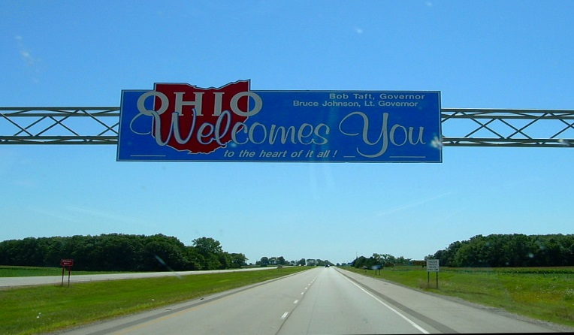
Which Circuit Has Appellate Jurisdiction?
Continued
Kalama v. Matson Navigation Co., Inc., presented an “odd scenario” which required the Sixth Circuit to “review non-final orders issued by the MDL transferee court in the E.D. of Pennsylvania.” 875 F.3d 297, 304 (6th Cir. 2017).
3d Cir.
6th Cir.
Notes:
Sharon: Let’s talk about another example, Kalama, which presented somewhat of an “odd scenario” in the Sixth Circuit.
In Kalama, Plaintiffs filed asbestos-liability suits in the N.D. of Ohio. The Court ruled that it lacked personal jurisdiction over certain defendants who were dismissed. The cases eventually were transferred and consolidated in the E.D. of Pennsylvania. The MDL court held that the N.D. of Ohio lacked personal jurisdiction over thousands of more defendants.
Plaintiffs’ cases were then remanded back to the N.D. of Ohio, which completely disposed of what was left of the consolidated cases, dismissing the remaining defendants. Various plaintiffs appealed from the N.D. of Ohio order as well as from the MDL court’s order to the 6th Cir.
This presented an “odd scenario” because the appeal called upon the 6th Cir. to review the non-final MDL orders which were issued outside the Court’s territorial jurisdiction.
Because the MDL court’s orders became reviewable only after plaintiff-appellants’ cases reached a final judgment in the N.D. of Ohio, the 6th Cir. determined that it did in fact have appellate jurisdiction.
So, in other words, if you can’t get to a court of appeals until the case is remanded, then the appeal follows you back (at least under this case).

Slide 7
When Can You Bring An Appeal?
“Like snowflakes, no two MDLs are exactly alike.” In re General Motors LLC Ignition Switch Litig., 2015 WL 3619584, at *8 (S.D.N.Y. June 10, 2015).
Notes:
Judge Benton: So this all begs the question—when can you bring an appeal? That answer may, as we hear, determine which circuit will decide the outcome of your case. And we don’t always all think alike!
Because no two MDLs are exactly alike, there is no one size fits all answer.
Sharon, can you help with this?
Let’s say you are one of many plaintiffs in a coordinated proceeding and your particular claim is dismissed, but you want to continue—can you appeal?

Slide 8
Final Judgment Rule
28 U.S.C. § 1291 “gives the courts of appeals jurisdiction over appeals from ‘all final decisions of the district courts.’” Gelboim v. Bank of Am. Corp., 135 S. Ct. 897, 898 (2015).
Rule 54(b) “permits district courts to authorize immediate appeal of dispositive rulings on separate claims in a civil action raising multiple claims.” Id. at 898-99.
Notes:
Sharon: This has been a hot topic for years.
[“Final Judgment Rule”: As a general matter, the federal courts of appeals have jurisdiction over only “final decisions” by a district court. Most litigants thus have to wait until the end of proceedings in the district court—when all issues have been decided and only execution of the judgment remains—before they can appeal.]
The Supreme Court resolved this in 2015 in Gelboim v. Bank of Am. Corp.
There, the JPML established an MDL for cases involving allegations that defendant-banks manipulated the London InterBank Offered Rate (“LIBOR”), which is used as a reference point in determining interest rates for financial instruments globally.
Over 60 actions were consolidated for pretrial proceedings in S.D.N.Y., including actions brought by Ellen Gelboim and Linda Zacher.
The “Gelboim-Zacher” complaint asserted a sole claim—that certain defendant-banks violated federal antitrust law.
The MDL court dismissed the Gelboim-Zacher complaint after determining that no plaintiff could assert a cognizable antitrust injury.

Slide 9
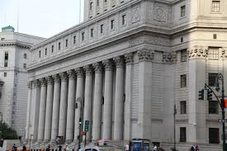
Final Judgment Rule
Continued
“This Court has determined sua sponte that it lacks jurisdiction over these appeals because a final order has not been issued by the district court as contemplated by 28 U.S.C. § 1291, and the orders appealed from did not dispose of all claims in the consolidated action.” In re LIBOR-Based Fin. Instruments Antitrust Litig., 2013 WL 9557843, at *1 (2d Cir. Oct. 30, 2013).
Notes:
Sharon: Gelboim-Zacher appealed immediately to the Second Circuit—the Circuit in which the S.D.N.Y. sits.
The Second Circuit determined sua sponte that it could not hear the Gelboim-Zacher appeal for lack of appellate jurisdiction. The MDL order determined the dismissal was not a final order because it did not dispose of all claims in the consolidated action.
The Supreme Court granted petitioners’ writ of certiorari to consider whether an MDL order dismissing a case removes it from consolidated proceedings, making it a final judgment which triggers a right to appeal.

Slide 10
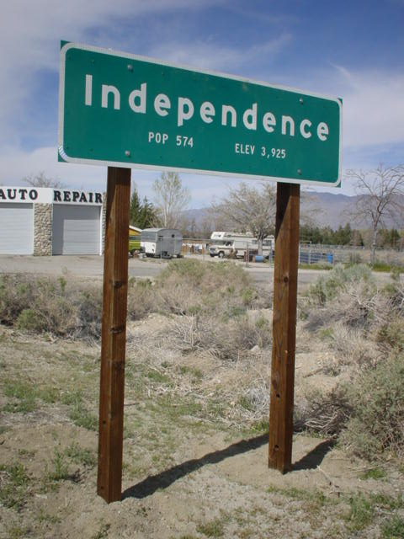
Final Judgment Rule
Continued
The “complaint retained its independent status for purposes of appellate jurisdiction under § 1291. Petitioners’ right to appeal ripened when the [MDL] Court dismissed their case, not upon eventual completion of multidistrict proceedings in all of the consolidated cases.” Gelboim, 135 S. Ct. at 902.
Section 1407 “did not meld the Gelboim-Zacher action and others in the MDL into a single unit.” Id. at 905.
Notes:
Sharon: This case was to resolve a four-way circuit split. [The First and Sixth Circuits would have heard the appeal; the Federal, Ninth, and Tenth Circuits would have declined jurisdiction over the appeal; the Second Circuit would have applied a presumption against hearing the appeal; and a jurisdictional decision in the remaining circuits would hinge on whether actions had been consolidated for limited purposes or “for all purposes.”]
The Supreme Court ultimately agreed with plaintiffs, holding that the Gelboim-Zacher complaint retained its independent status for purposes of appellate jurisdiction and that Gelboim-Zacher’s right to appeal ripened when the district court dismissed their case, not upon the ultimate completion of the MDL proceedings in all of the consolidated cases.

Slide 11
Is It Final?
Fee Awards
MDL issues award of attorneys’ fees.
FINAL OR NOT FINAL?
Notes:
Judge Benton: So the question is—what kinds of MDL orders are appealable and which are not? Gretchen, can you help?
Gretchen: Absolutely, let’s walk through some examples.
In the MDL context, fees are awarded to coordinating counsel sometimes, and may anticipate additional requests or a final fee award in the future.
Answer—it depends!
[Final fee awards; individual counsel versus committee.]
Order “foresees further and additional action by the district court, thus continuing, but not concluding, the fee litigation.” In re Diet Drugs Prods. Liab. Litig., 401 F.3d 143, 156-57 (3d Cir. 2005) (emphasis added). May not be final.

Slide 12
Is It Final?
Continued
Class Action Certification
MDL issues class certification decision.
FINAL OR NOT FINAL?
Notes:
Gretchen: Answer—neither!
Whether to allow immediate interlocutory appeal of a class certification decision is committed to the discretion of the court of appeals. See Microsoft Corp. v. Baker, 137 S. Ct. 1702, 1710 (2017).
On interlocutory appeal, the MDL decision would be reviewed by the court of appeals for the transferee court.
But, if no interlocutory appeal, if later the case is remanded back to the transferor court, the decision may be addressed on appeal by the court of appeals for the original district.

Slide 13
Is It Final?
Continued
In re Food Lion, Inc., Fair Labor Standards Act “Effective Scheduling” Litig., 73 F.3d 528 (4th Cir. 1996).
FedEx Ground Package Sys., Inc. v. U.S. J.P.M.L., 662 F.3d 887 (7th Cir. 2011).
Notes:
Judge Benton: Now that we have a basic rule, let’s add some complexities. We heard earlier about Food Lion. Gretchen, could you tell us about that case and the issues presented there?

Slide 14
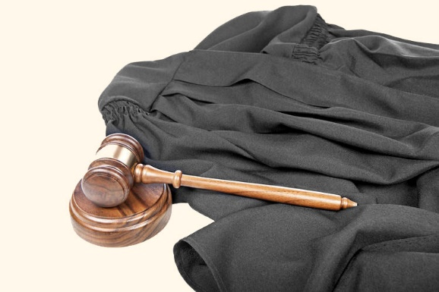
Is It Final?
Continued
In re Food Lion, Inc., Fair Labor Standards Act “Effective Scheduling” Litig., 73 F.3d 528 (4th Cir. 1996).
Notes:
Gretchen: Yes, this is a very interesting case. In Food Lion, the MDL court granted the defendant complete summary judgment in multiple actions, and (on essentially the same grounds) partial summary judgment in other actions, dismissing the claims of certain plaintiffs entirely while leaving claims of certain co-plaintiffs. On the recommendation of the MDL court, the Panel remanded the live actions.
Plaintiffs whose claims were dismissed by the MDL court appealed to the Fourth Circuit. The Fourth Circuit recognized that there was something wrong here. It would be deciding claims dismissed for one set of plaintiffs, while the other set of claims remained unreviewable because different claims were both live and now remanded to an entirely different circuit. The Fourth Circuit concluded that the MDL court should have entered partial final judgments under Rule 54(b) and that the Panel should have separated the claims of the dismissed plaintiffs before remand.
The majority then sua sponte invoked writ of mandamus and ordered the Panel to retransfer the claims that the MDL court had dismissed, and for the MDL court to enter final judgment under Rule 54(b) as to those claims. Why? So all of the appeals could be heard by the same court.

Slide 15
Is It Final?
Continued
FedEx Ground Package Sys., Inc. v. U.S. J.P.M.L., 662 F.3d 887 (7th Cir. 2011).
Notes:
Gretchen: Food Lion, however, was distinguished by Seventh Circuit decision, FedEx.
[Add short fact description.]
The Seventh Circuit denied FedEx’s writ of mandamus, noting that (1) the Court did not read Food Lion to hold “that all MDL cases must be managed to ensure that all related appeals go to only the circuit with jurisdiction over the transferee court,” and (2) Food Lion—as opposed to FedEx—involved only federal law, which may have affected the Fourth Circuit’s analysis.

Slide 16
Consolidation of Appeals
“Consolidation . . . may be ordered where the court in its discretion deems it appropriate and in the interests of justice, but each of the matters to be consolidated must be within the jurisdiction of the court.” United States v. State of Wash., 573 F.2d 1121, 1123 (9th Cir. 1978).
“In consolidated appeals the separate appeals do not merge into one. The parties do not proceed as a single appellant.” Fed. R. App. P. 3, Committee Cmt. (1998).
Court may decide on its own to consolidate.
Notes:
Judge Benton: As we see, an MDL may invoke dozens of appeals throughout the MDL process, not only at the conclusion. So how does the court of appeals manage all of this? Gretchen?
Gretchen: A common example would be multiple objections to a consolidated class action settlement.
Another common example would be if multiple plaintiffs and their counsel were unhappy with fee awards. If not coordinated amongst themselves, then the court may consolidate sua sponte.
In certain circumstances, the court of appeals may order consolidation.
Judge Benton: [Please add insights on benefits and pitfalls of consolidation.]

Slide 17
Consolidation of Appeals
Continued
Practical Considerations:
Consolidation may make sense from an efficiency standpoint.
It may be possible to consolidate appeals from more than one ruling.
You may be limited to a single brief and one person for argument. See, e.g., 10th Cir. L. Civ. R. 31.3, 34.1(B).
Notes:
Gretchen: Here are a few practical considerations.
First, consolidation may make sense from an efficiency standpoint. You may make it easier for the court and yourself by combining.
For example, it may be possible to consolidate appeals from more than one ruling.
You may, however, be limited to a single brief, and perhaps only one person for argument, such as under the Tenth Circuit Local Rules.
You have to weigh the pros and cons here.
If you’re really unhappy, you can move to de-consolidate. You would have to show an individualized issue. This may not result in a separate hearing, but you may get separate time in argument and brief.

Slide 18
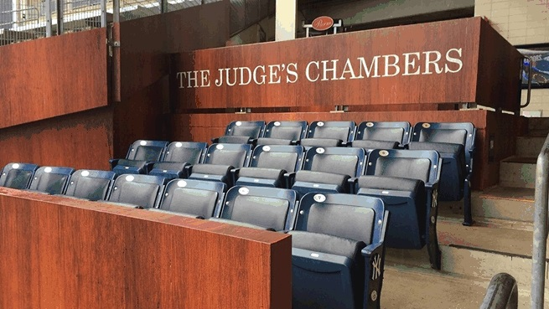
Appealing Bellwether Trials
Bellwether trials may frame issues for future discovery, trials, and settlement discussions.
Notes:
Judge Benton: For our last section, let’s change topics. Bellwether trials are an increasingly popular tool for managing MDLs.
Choosing an appropriate MDL bellwether may be difficult. You will need to find an appropriate candidate (potentially using a Lexecon waiver, as you have heard about earlier). Assuming there is a representative trial, its outcome will plainly impact future discovery, trials, and settlements.
Let’s say you are either the losing party to the trial, or an unhappy different party in the MDL court who just saw the value of their case decline. What can you do?
Gretchen, I am coming to you again. Can you walk us through the considerations?

Slide 19
Appealing Bellwether Trials
Continued
In re DePuy Orthopaedics, Inc., 870 F.3d 345 (5th Cir. 2017).
Notes:
Gretchen: DePuy Orthopaedics is a very interesting example of just this circumstance. There, the 9,300 plaintiffs brought product liability claims for an allegedly defective hip-implant device.
The parties agreed to a proposal to try certain cases as bellwether trials before the MDL court (N.D. of Texas). The proposal stated that “Defendants’ Lead Counsel have [] agreed that they will not raise a venue objection (i.e., a Lexecon objection) to any cases in the MDL proceeding being tried in the N.D. of Texas.”
The 1st bellwether involved a single case transferred from the D. of Montana. The jury found for defendants.
The 2nd bellwether involved five consolidated cases, all directly filed by Texas plaintiffs. This time, the jury returned a $502 mil. verdict. Defendants appealed and moved to stay future bellwethers pending the appeal, noting that they waived venue objections only with respect to the first 2 bellwethers. The court denied a stay and stated that defendants waived all venue objections to trying cases in the MDL court.
The MDL court then selected 6 cases—all filed by California plaintiffs—for a 3rd bellwether trial. The jury returned a $1.04 bil. verdict. Defendants appealed, reiterating their waiver assertions.
Finally, the MDL court issued an order selecting 10 cases with New York plaintiffs for a 4th bellwether. Defendants moved to vacate the order and dismiss the claims for lack of personal jurisdiction, reiterating their waiver assertions. The MDL court denied both motions. Defendants, facing an impending 4th bellwether, asked the 5th Cir. to rule before then.

Slide 20
Appealing Bellwether Trials
Continued
“That was grave error: At most, [defendants’] waivers included ambiguous language that did not indicate a clear intent to waive all Lexecon objections to trials before the MDL court.” In re Depuy Orthopaedics, Inc., 870 F.3d at 351.
Defendants “must show that they have ‘no other adequate means’ to obtain relief. That is a high bar . . . [F]or appeal to be an inadequate remedy, there must be ‘some obstacle to relief beyond litigation costs that renders obtaining relief not just expensive but effectively unobtainable.’” Id. at 352-53.
Notes:
Gretchen: The Fifth Circuit denied mandamus, holding that defendants had the usual and adequate remedy of ordinary appeal.
Additionally, the Fifth Circuit held that defendants limited their venue waivers to the first two bellwether trials only, and that the MDL court erred by declaring that defendants had globally and permanently waived their objections to venue and personal jurisdiction.
That is, the Fifth Circuit held that the MDL judge’s ruling regarding defendants’ objection waivers was “patently erroneous” and requested that the court cancel the upcoming bellwether trial, but stopped short of ordering the judge to do so because defendants had not shown that they had no other adequate means to attain the relief sought.
[Implications]

Slide 21
Q&A
Notes:
Judge Benton: Thanks very much for your time today and for staying with us through this final panel.
We’ll now stop for any questions you may have.

Slide 22
MDL Appellate Issues
Hon. Duane Benton
Gretchen Garrison
Sharon Nelles
March 26, 2019
Notes:
[Any concluding remarks]

