Slide 1
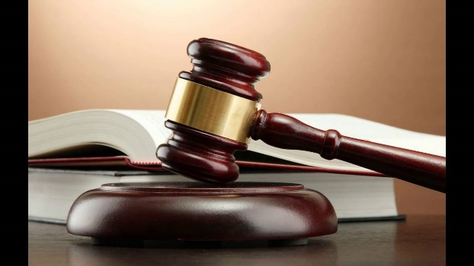
MDL Coordination with State Courts
Judge Barbara Rothstein / USDC - DC
Dawn Barrios / Barrios Kingsdorf & Casteix, L.L.P.
Julie Callsen / Tucker Ellis LLP
March 26, 2019

Slide 2
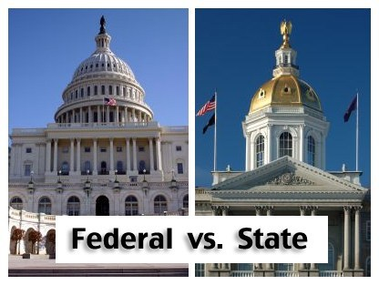
WHY STATE COURT VERSUS FEDERAL COURT
Lack of diversity
Relinquishing control of your case
Perception of “black hole”
Assessment on cases in MDLs, classes, or mass actions in federal court

Slide 3
WHY STATE COURT VERSUS FEDERAL COURT
Comparison of status of federal cases and state cases (to get to trial)
MDLs take time to be assigned and get organized
State cases may be more advanced and may be in discovery

Slide 4
SHOULD THERE BE COORDINATION?
Coordination is favored (Manual for Complex Litigation, Fourth (2015)
“to minimize conflicts that distract from the primary goal of resolving the parties disputes”, §20.313
“to reduce the costs, delays, and duplication of effort that often stem from such dispersed litigation”, §20.313

Slide 5
SHOULD THERE BE COORDINATION?
Production of evidence and depositions only done once

Slide 6
Challenges to coordination
Different rules/standards – Daubert/Frye
Laws vary from state to state
Difference in procedures
Protective orders
Sealing of records

Slide 7
STRATEGIES TO ACHIEVE COORDINATION
Judges organize and coordinate with each other
Special Master over all cases for certain issues
(discovery, settlement)
One electronically shared document depository
MDL Website – State Website

Slide 8
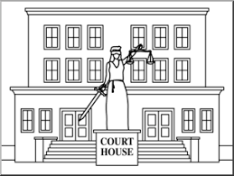
STRATEGIES TO ACHIEVE COORDINATION
MDL and state court federal-state liaison counsel
Joint pretrial motions and hearings
Coordination of trial dates

Slide 9
AUTHORITIES
Manual for Complex Litigation (4th Ed.)
Manual for Cooperation Between State and Federal Courts, Federal Judicial Center, National Center for State Courts, State Justice Institute
JPML Multijurisdiction Litigation https://multijurisdictionlitigation.wordpress.com/
James G. Apple, Paula L. Hannaford, & G. Thomas Munsterman, Manual for Cooperation Between State and Federal Courts (Federal Judicial Center, National Center for State Courts, and State Justice Institute, 1997)*^
Federal Judicial Center & National Center for State Courts, Coordinating Multijurisdiction Litigation: A Pocket Guide for Judges (2013)*
Barbara J. Rothstein & Catherine R. Borden, Managing Multidistrict Litigation in Products Liability Cases: A Pocket Guide for Transferee Judges (Federal Judicial Center & Judicial Panel on Multidistrict Litigation, 2011)^

