Slide 1
Selection of Lead Counsel and Steering Committees
The Honorable John Lungstrum
The Honorable Catherine Perry
Abby McClellan Stueve Siegel Hanson LLP
s in MDLs and Class Actions
Continuing Legal Education
March 26, 2019
Current Issues in MDLs and Class Actions
Continuing Legal Education

Slide 2
“Determining the appropriate leadership structure and selecting the right lawyers to fill the positions is one of the first and most important case-management tasks.”
Guidelines for Best Practices for Large and Mass-Tort MDLs, Bolch Judicial Institute, Duke Law School 09/2018
“[C]hoosing counsel is probably one of the most critical decisions a judge makes in a MDL or mass tort case.
The Honorable Stanwood R. Duval, Considerations in Choosing Counsel for Multidistrict Litigation Cases and Mass Tort Cases , 74 Louisiana Law Review 391–395 (2014)
“Few decisions by the court in complex litigation are as difficult and sensitive as the appointment of designated counsel.”
Manual for Complex Litigation, Fourth. Federal Judicial Center 2004.

Slide 3
Overview
Leadership Structure
Firm Appointments vs. Individual Appointments
Slates
Repeat Players
Diversity of Selections
Ability to Manage Litigation
Ability to Finance Litigation
Application and Hearing Process
References
Length of Appointment

Slide 4
Leadership Structure
The transferee judge should assess the needs of the litigation to establish the appropriate leadership structure.
Factors to consider:
Nature of the claims
Number of cases
Variety and complexity of interests involved
Based on the needs of the litigation the judge may select the following:
Lead Counsel
Liaison Counsel
Steering Committee
Settlement Committee
Defense Leadership

Slide 5
Leadership Structure
Lead Counsel: Charged with formulating and presenting positions on substantive procedural issues during the litigation. Depending on the size and complexity of the case, it may be appropriate to appoint more than one individual to serve as lead counsel
Liaison Counsel: Charged with essentially administrative matters, such as communications between the court and other counsel, convening meetings of counsel, advising parties of developments, and otherwise assisting in the coordination of activities and positions
Steering Committee: Often composed of a broader set of attorneys who each focus on specific aspects of the day-to-day litigation, such as discovery, technology, briefing, science, coordination with state litigation, and trial counsel
Settlement Committee: Comprised of representatives from both sides to conduct ongoing, regular settlement negotiations
Defense Leadership: In cases involving numerous defendants it may be necessary to appoint a leadership team for the Defense and/or a Defense liaison counsel

Slide 6
Firm vs. Individual Appointment
Firm Appointment: | Individual appointment:
Difficult to hold firm accountable Difficult to ensure the work is being done by leaders of the firm rather than excessive delegation to less experiences attorneys | Ensures the individual applying is the one doing the work (accountability) Can easier judge the individual applicant’s ability to work as a team

Slide 7
Slates
Historically: private ordering was the predominant form of appointment and selection, with lawyers agreeing to who should be appointed lead counsel and to committees and presenting a “slate” of lawyers to the court for consideration.
Now: judges see lawyers’ self-selection as one of many considerations in selecting the best leadership team possible.
The Manual for Complex Litigation, Fourth recommends several factors of the proposed “slate” to ensure those attorneys are committed to the litigation. These factors include:
qualifications, functions, organization, and compensation of designated counsel;
whether there has been full disclosure of all agreements and understandings among counsel;
the attorneys’ resources, commitment, and qualifications to accomplish the assigned tasks; and
the attorneys’ ability to command the respect of their colleagues and work cooperatively with opposing counsel and the court—experience in similar roles in other litigation may be useful, but an attorney may have generated personal antagonisms during prior proceeding.

Slide 8
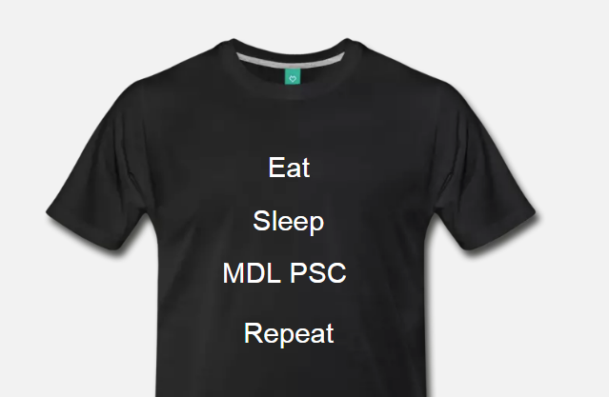
Repeat Players
Pros:
Experience managing and
financing complex litigation
Working relationships with
other MDL/Class Counsel
Cons:
Lacks diversity
Reduces fresh outlooks and innovative ideas
Goal: Have a balance of new and repeat players

Slide 9
Diversity of Selections
Diversity should be a valued component in selecting case leadership. The same way that diversity improves companies’ bottom lines, litigants and the civil justice system benefit from diversity of leadership.
Types of diversity to consider:
Demographic
Gender
Race and National Origin
Age
Sexual Orientation
Experience

Slide 10
Ability to Manage Litigation
Team Player
Can the attorney play well in
the sandbox?
Expertise and Experience
The expertise and experience should be diverse
Demands of Applicants’ Time
Involvement in other MDLs/Cases
Firm Resources Available
This includes financial resources and human capital

Slide 11
Ability to Finance Litigation
In large and mass-tort MDLs, the cost can be exceedingly high. For example, the leadership in the Vioxx MDL fronted 41 million.
The ability to provide financial and other recourses is a significant factor in determining appointment.
Principal/Agent Relationship: With new finance mechanisms emerging there is a push to disclose the source of the funding and whether that funder has a voice in the litigation process, costs, or settlement sign-off.
To keep financial information confidential judges may seek this information be disclosed for in camera review.

Slide 12
Application and Hearing Process
As soon as possible a PTO should be issued by the transferee judge that outlines the following:
Application process and requirements
Whether there is a preference for self-ordering (slates) vs. individual applications, or another process.
Anticipated structure of leadership
Whether there will be a hearing process

Slide 13
Application and Hearing Process
A written application requirement is the favored approach to evaluate counsel.
Some courts prefer to use traditional motion practice, with an opening brief, an opposition, and a reply.
Some courts make their selections based on single submissions from counsel to streamline the process and avoid ad hominem attacks.
Other courts find it helpful for counsel to file short responsive briefs explaining why they should be appointed over other applicants for the same position
The contents of the application should include the same information to facilitate comparison. An example of requirements:
willingness and availability to commit to a time-consuming project
ability to work cooperatively with others
professional experience in the type of litigation; and
willingness to commit the necessary resources to pursue the matter.

Slide 14
Application and Hearing Process
A hearing can be helpful when there are a large
amount of applicants.
During the hearing the judge can assess the
Applicants’:
Demeanor
Skills
Interactions with other counsel and court staff
The judge will often provide time for the applicants to address the court and will allow the judge to ask specific questions such as:
Other case responsibilities
Ability to be actively involved in the litigation
Qualifications

Slide 15
References
“A lawyer must remember that maintaining credibility, integrity, and a high level of professionalism in his or her dealings will always serve him or her well”
Judge Stanwood R. Duval, Considerations in Choosing Counsel for Multidistrict Litigation Cases and Mass Tort Cases , 74 Louisiana Law Review at 394 (2014)
Judges may ask for judicial and special master references in appointment applications
Judicial colleagues and special masters are valuable sources about the competence and professionalism of counsel who have appeared before them.

Slide 16
Length of Appointment
There are a variety of judicial preferences:
Interim appointment followed by standing appointment
1 year appointment
Annual application; or
After one year standing appointment
Reconstitute the leadership if necessary

Slide 17
Questions

